Slide 1
Institute for Local Government Winter Webinar – December 4, 2012
City-County-School Partnerships to Create Safe Routes to Schools

Slide 2

City-County-School Partnership
How did a City-County-School Partnership lead to the creation and successful implementation of the Solano Safe Routes to School Program?

Slide 3
Solano Transportation Authority
Presentation overview:
Initial Steps
Key Players
Milestones
Where is the funding?
Current Priorities

Slide 4

City-County-School Partnership
“Do what you can, with what you have, where you are.”
Theodore Roosevelt

Slide 5

Solano County
Solano County:
425,000 people countywide
Heart of the Northern California Mega-Region between San Francisco Bay Area and the Sacramento Metropolitan Region, and east of Napa and Sonoma wine regions

Slide 6









Solano Transportation Authority
Congestion Management Agency for Solano County, 7 cities
Plan, Fund, and Deliver transportation projects and programs
Responsible for coordination and funding of Solano Safe Routes to School Program
Seven Mayors and one Supervisor on the STA Board
Eight Public Works Directors on Technical Committee

Slide 7

Solano County’s Call to Action
In 2007 a high percentage of childhood obesity was reported in Solano County
A call to action was issued by Solano County Board of Supervisors
A summit was held to draw attention to the issue
In Solano County, 60% of adults are overweight or obese. The rate of overweight children is among the highest in the Bay Area. The average 10-year old boy is 11 pounds heavier than a generation ago according to Dr. Ronald Chapman, Solano County Health Officer.

Slide 8

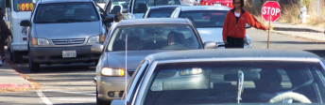

STA SR2S Program Goals
STA Board adopted three SR2S goals:
  Increase healthy and safe alternatives to driving alone.
  Reduce number of driving alone/chauffeured trips and the number of student vs. vehicle accidents along routes to schools.
  Maximize interagency cooperation in all SR2S efforts.

Slide 9
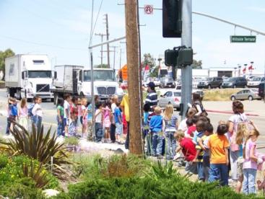
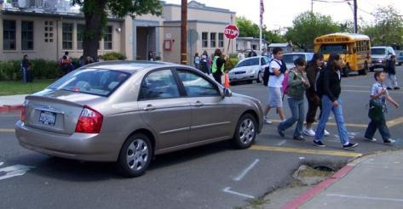
Solano County’s Call to Action
Roadways congested with traffic, and environments damaged by vehicle emissions present safety concerns for:
  Pedestrians
  Bicyclists

Slide 10







Solano County Schools
Solano County has 7 school districts:
  82 schools countywide
  56 Elementary Schools
  14 Middle Schools
  12 High Schools
  There are a total of 64,180 students
  countywide.

Slide 11
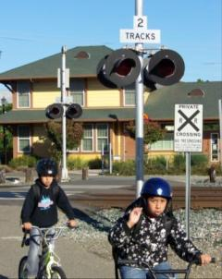
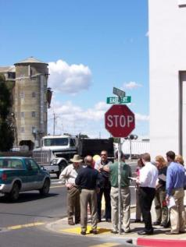
Dixon
Solano County Schools
Several school districts changed district boundaries.
Several school districts closed schools.
At least 2 school districts school bus programs were eliminated

Slide 12
Solano County’s Call to Action
“We cannot always build the future of our youth, but we can build our youth for the future.”
Franklin Delano Roosevelt

Slide 13









Call to Action
STA proposed, Solano County and all 7 cities agreed to develop a countywide SR2S study to address issue
Public Health Department got involved with STA as facilitator
Hired consultant to develop a countywide SR2S study.

Slide 14
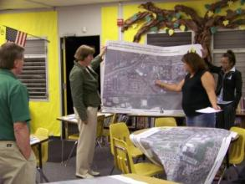
Starting Safe Routes to School
STA proposed to involve school districts, cities, County law enforcement, engineers and advocates
Recruited members for a Countywide Steering Committee for the study:
  Two Public Works Directors
  Two Police Chiefs
  Two School District Superintendents
  Two Bicycle & Pedestrian Advocates
  One Air Quality District Representative
  One County Public Health Department Representative

Slide 15
Change
“If you want to make enemies, try to change something.”
Woodrow Wilson

Slide 16
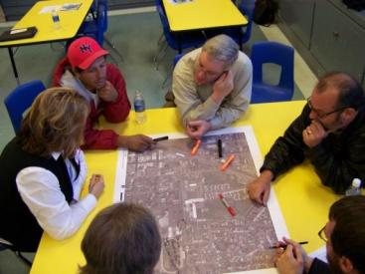
Starting Safe Routes to School
Developed planning process that would work best for Solano County.
Early buy-in from all school Superintendents, County Sheriff and Police Chiefs, School Board members, City Council members and Board of Supervisors

Slide 17
Starting Safe Routes to School
“It’s the little details that are vital. Little things make big things happen.”
John Wooden

Slide 18


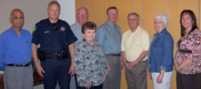
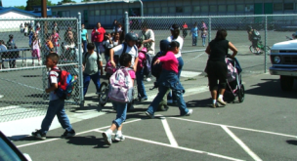
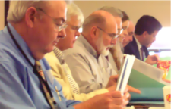
Phase 2: Created Community SR2S Plans
Built a Team (Community Task Force)
  City Council Representative
  School District Representative
  Public Safety Representative
  (Police Departments)
  Public Works Representative
  Bicycle Advisory Representative
  Pedestrian Advisory Representative
Set an Example
  Each Community Task Force selected a pilot school for a walking audit & planning event
  Other schools held planning events afterwards
Made the Plans Official
  Community Task Forces reviewed publicly recommended projects and programs to add into the community SR2S Plan
  Community SR2S Plans were recommended to the city council and school board for adoption
  Required community boards and schools to adopt same

Slide 19
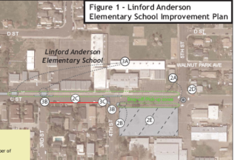
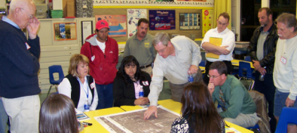
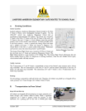
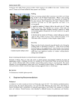
Phase 3: Community Adoption
City Councils and School Boards:
Recommended projects and programs found in the community SR2S plan to the STA for incorporation into the Countywide STA SR2S Plan
Appointed community SR2S task force to continue to plan and implement SR2S projects and programs
Adopted community SR2S Plan as the community task force’s guiding document.

Slide 20
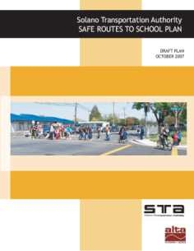
Draft Countywide Priorities
Mostly Education and Encouragement activities.
  Schools requested uniform educational materials and incentives/prizes
  Countywide media campaigns
  Suggested safe routes to school
  maps and classroom activities
  that teach to standards
  Increased coordination efforts between schools, cities, law enforcement and engineering

Slide 21
Presentation Overview
Opportunity
“Opportunity is missed by most people, because it is dressed in overalls and looks like work.”
Thomas Edison

Slide 22
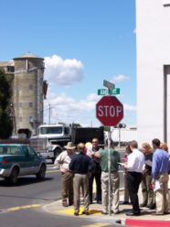
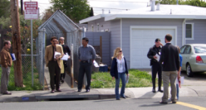
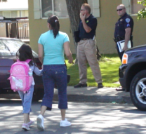
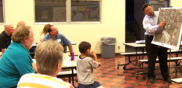
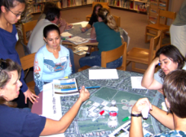
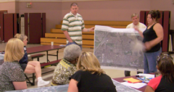
Walking Audit and Planning Events
Two-part event
Afternoon walking audit during school release
  Available task force members observe safety issues
  Photographs of identified issues provided for evening presentation
Evening planning event
  Presentation of SR2S project and program basics
  Public reviews photographs from audit
  Public plans projects and programs with large aerial maps and SR2S Toolkits.

Slide 23
Events: What we learned
Two-part event
Afternoon walking audit during school release
  Discussed hotspots with
  crossing guards/duties to take good photos
  Carried event flyers for curious parents
Evening planning event
  OUTREACH!
  Students love maps
  Parents read flyers at Back to School nights and Open
  Houses, not take-home flyers

Slide 24

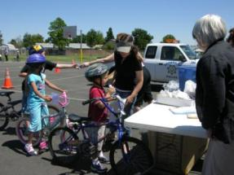
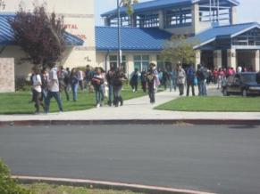
Implementation by STA
STA signed joint use agreements with all 7 cities and school districts
STA developed funding for the Safe Routes to School Program
STA provides and manages resources and coordinates 8 advisory committees

Slide 25

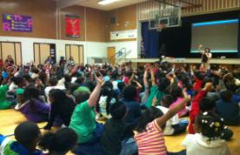
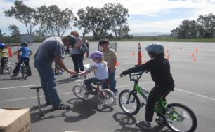
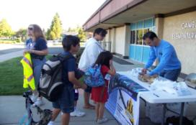
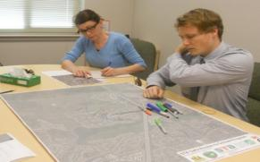
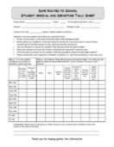
The 5 E’s
ducation
ncouragement
nforcement
ngineering
valuation
Notes:
4 E’s make up the Safe Routes to School Program, 3 program elements and 1 engineering element.
Education: Teaches children about the benefits of walking and bicycling and the positive impacts these activities have on personal health and the environment.
Encouragment: Free program events generate excitement and interest in walking and bicycling by rewarding participation and educating children and adults about safety and the benefits of bicycling and walking.
Enforcement: Strategies to deter unsafe behavior of drivers, bicyclists and pedestrians and encouraging all road users to obey traffic safety laws and to share the road.
Engineering: Improvements designed to improve the safety of pedestrians, bicyclists and motorists along school commute routes.

Slide 26
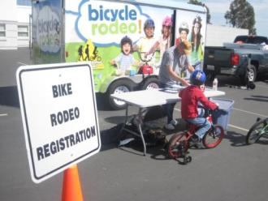
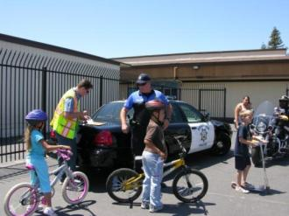
Implementation by County
Solano County Public Health implements education and encouragement part of program:
  Dedicated staff to coordinate with schools and communities

Slide 27
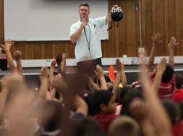
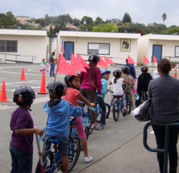
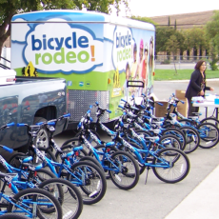
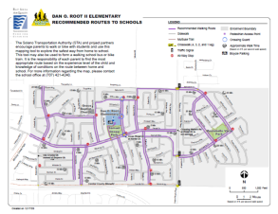
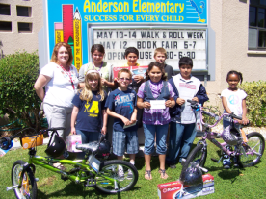
FY 2012-13 Program Activities
Education &
Encouragement
Safety Assemblies
Bicycle Rodeos
Walk & Roll Events
Suggested Route to School Maps
Walking School Bus Program
Notes:
EDUCATION/ENCOURAGEMENT
FY 2011-12, 55 events were held reaching 12,811 students
1 walking school bus was started at Markham Elementary School, which includes an ongoing parent training program.

Slide 28
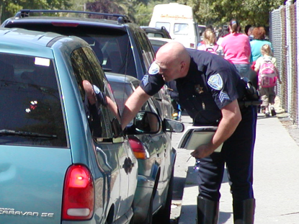
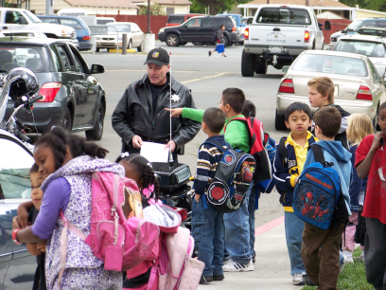
FY 2012-13 Program Activities
Enforcement
Best Practices Pilots & Resource Guide
Targeted/Enhanced Enforcement
Crossing Guard Training Manual and Video
Bicycle Rodeo Video
Notes:
Enforcement
Through the $100,000 STA SR2S Enforcement grant:
Maximum enforcement was provided to 7 schools in Fairfield-Suisun School District.
47 citations, 63 warnings were issued and 3 vehicles were towed as a result of enforcement.
Suisun City PD developed a countywide crossing guard manual and test/Bike Rodeo DVD.

Slide 29
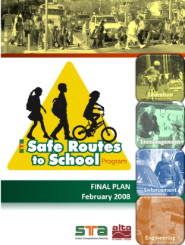
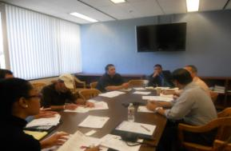
FY 2012-13 Program Activities
Engineering
Update to 2008 Plan
Community Task Forces
Walking Audits
Locally Adopted Plans
Shared Local Priorities = Countywide Program Priorities
Notes:
Engineering
22 Community Task Force meetings were held (between 7 Community Task Forces countywide) and 17 walk audits were conducted for the SR2S Plan Update.
Interactive mapping tool was developed for the SR2S website.
Expected completion date for the SR2S Plan Update: November 2012.

Slide 30
Benefits of School Participation
Through our evaluation results, it was determined that schools who
actively participate in SR2S program activities have increased their number of students who walk to school.
Fairfield, CA
Participation
Anna Kyle and Cordelia Hills Elementary schools are actively involved in SR2S program activities.
Principals at the school sites support the program and have strong PTA’s.
Anna Kyle Elementary School has one active walking school bus.
Notes:
Anna Kyle ES, 46% walking in 2011 to 51% walking in 2012 --5% increase
Cordelia Hills ES, 16% walking in 2011 to 25% walking in 2012—9% increase

Slide 31
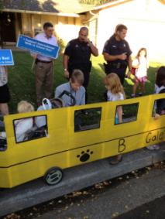
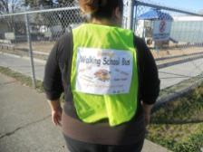
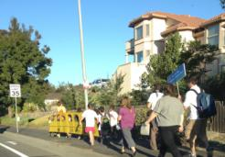
Pilot Walking School Bus Project
Through our partnership with Solano County Public
Health the Solano SR2S Program implemented a
walking School Bus/Bicycle Train pilot project at local
elementary schools to encourage children to walk or
ride most days of the week.
Pilot Program Success:
The WSB pilot project produced 5 walking school
buses.
(1) Markham Elementary, Vacaville CA
(2) B.Gale Wilson Elementary, Fairfield CA
(1) Anna Kyle Elementary, Fairfield CA
(1) Matthew Turner Elementary, Benicia CA

Slide 32
Pilot Walking School Bus Project
The Pilot Walking School Bus (WSB) project has
tremendous potential as a sustainable component of the
SR2S Education/Encouragement Program.
Steps utilized during pilot project implementation:
Generate meetings and presentation(s) the support from school administration, in particular the school principal.
Conduct several meetings with parent groups.
Conduct volunteer trainings and registration of volunteers
Disseminate and collect student participant-parent permission slips
Complete several practice WSB routes; develop timelines for routes
Provide continuous assistance and support to the WSB parent volunteers and school administration
Greatest Challenge
Recruiting parent volunteers to lead the WSB’s.

Slide 33

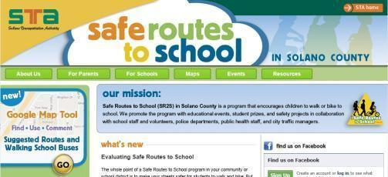
Implementation by STA
STA submitted countywide Safe Routes to School grant applications to 2 programs
STA Safe Routes to School Program/Funding Strategy
  Developed after the STA Board adopted the Countywide STA SR2S Plan in February 2008
Created SR2S
website

Slide 34
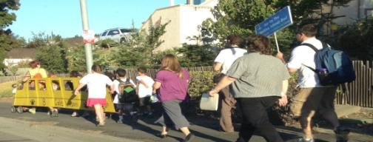
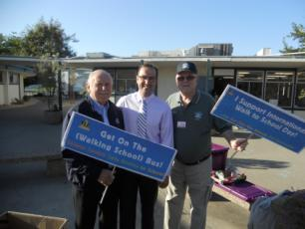
Walking School Bus Program
STA SR2S Program was awarded a $500,000 federal grant to implement a countywide walking school bus program.
Walking School Bus Program will be implemented in January 2013 with two new part-time WSB Coordinators.

Slide 35
SR2S Program Funding

Slide 36

Funding of SR2S Program
  $3.96M total for non-infrastructure program since 2008
    MTC/STA grants: $2.90M
    Federal SRTS grant: $0.50M
    Air District Grants: $0.55M
    No State or Local funding for STA non-infrastructure program
  $10M in completed or developing SR2S engineering projects in the last 4 years
    Compared to $1.1M for engineering in the 10 years prior to the 2008 plan
    $1.2M requested for engineering for next 4 years (OBAG)

Slide 37
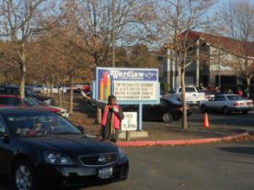
2012 Plan Update
The SR2S Plan update is currently underway and will be completed in fall 2012.
During the process:
Seventeen (17) walk audits conducted countywide-indicate need for additional infrastructure funding.
Draft lists of priority projects identified for each community in Solano County.
Community Task Forces are meeting to discuss, review and prioritize projects.
$3M of infrastructure needs were identified, $2M of which could be priority projects.
Notes:
During the process:
Seventeen (17) walk audits were conducted countywide indicating the need for additional infrastructure funding to create safer walking/biking environments around schools.
Draft lists of priority projects have been identified for each community in Solano County.
Many of the schools in the county are located in areas where there have been recent STA
Community Based Transportation Plans studies. The most recently completed plans include
Vacaville with an emphasis on the Markham neighborhood, and East Fairfield, which has
close proximity to two high schools and is impacted by the closure of Sullivan Middle
School.

Slide 38
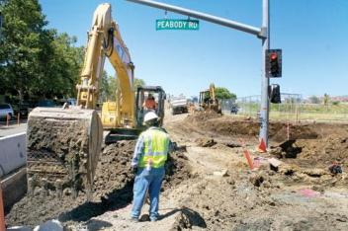
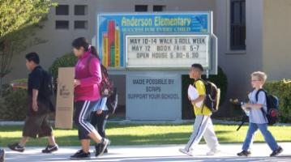
Completed Projects
Past projects identified in the 2008 Plan
were successfully completed
30 Radar speed signs installed countywide
Flashing Crosswalk installed (SR-113), Dixon CA
Improvements were made at:
Will C. Wood HS, Vacaville CA
Steffan Manor Elementary, Vallejo CA
Anderson Elementary, Dixon CA
Benicia High School, Benicia CA
Notes:
Improvements were made:
Will C Wood, Vacaville CA: Peabody/Marshall Rd intersection pedestrian improvements, Widened sidewalk along Marshall
Steffan Manor Vallejo CA : Sidewalk widening and high visibility crosswalks installed
Anderson, Dixon CA : Widened sidewalk and adjusted crosswalks in front of school. SR-113 Flashing Crosswalk
Benicia HS: Military & Denfield intersection, Military Road Diet

Slide 39
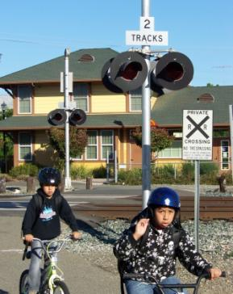
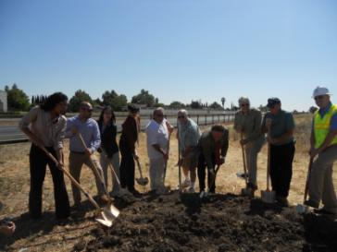
Countywide Priority SR2S Projects
SR 12/Grizzly Island Trail, Suisun City
West B. St. Pedestrian Uncrossing, Dixon
Improvements for Hogan school site, Vallejo

Slide 40










Partnership = Success
“Alone we can do so little, together we can do so much.”
Helen Keller
Our kids. Our schools. Our communities

Slide 41


More Information
More information online:
www.SolanoSR2S.ca.gov
www.facebook.com/solanoSR2S
Danelle Carey, SR2S Program Manager, Solano Transportation Authority
Daryl K. Halls, Executive Director, Solano Transportation Authority
www.sta.ca.gov 707-424-6075 dcarey@sta-snci.com

