Slide 1
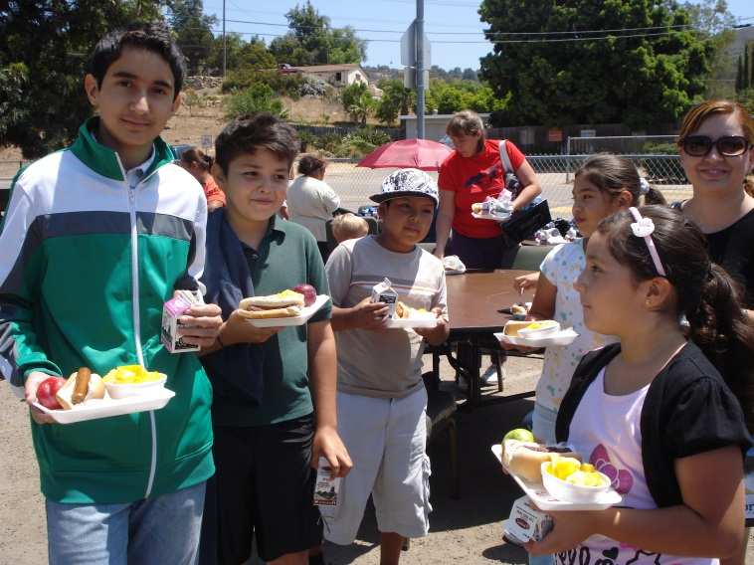
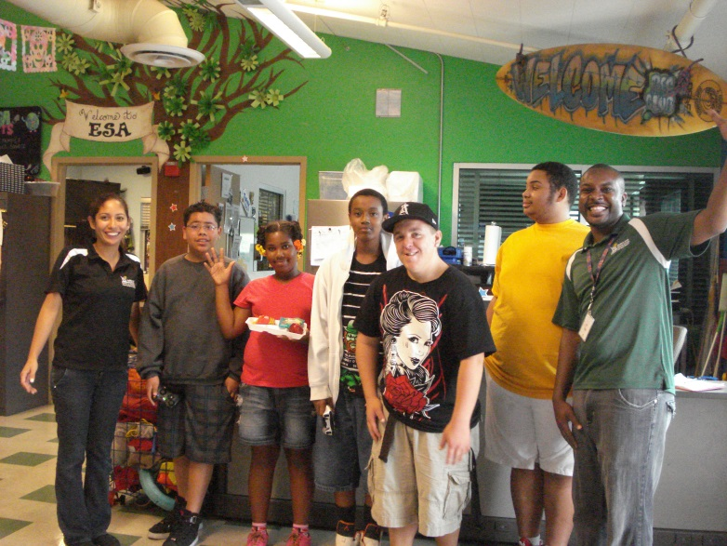
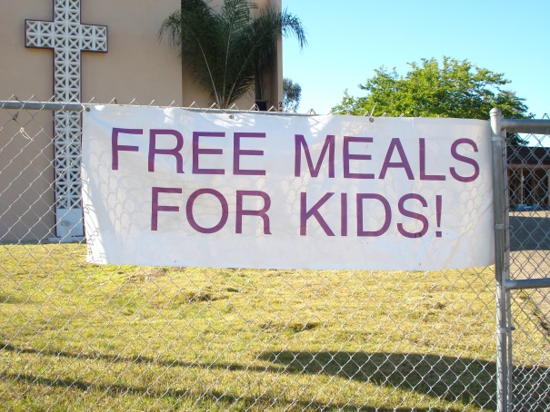
Faith-based: why not?
a.b. vines ministries
Angela Kretschmar, Executive Director

Slide 2
WHAT DO YOU HAVE?
Location
Volunteers
Time
Space
Organization Moral Support

Slide 3
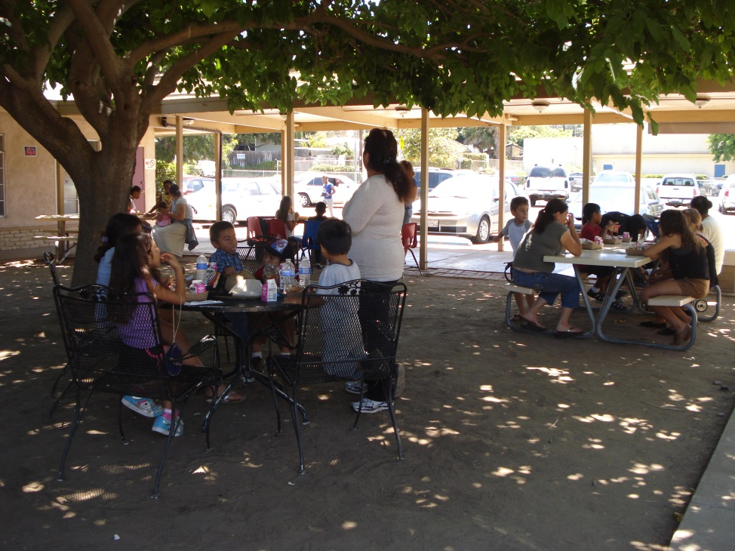
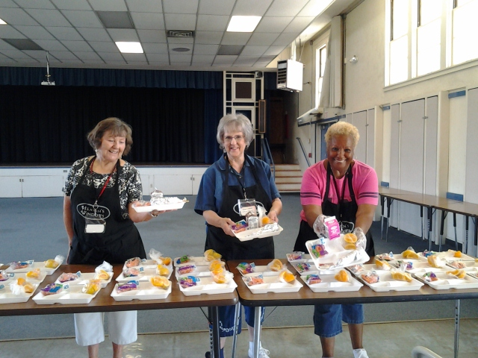
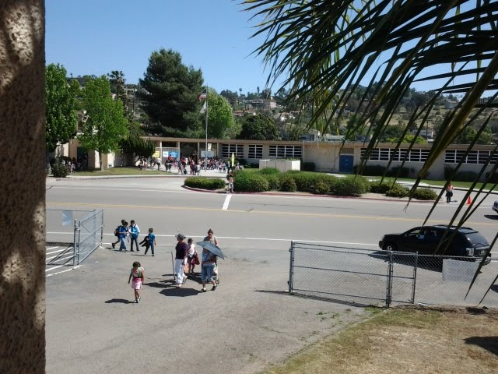

Slide 4
WHAT ARE you ALREADY DOING?
Relationship with your neighborhood
Relationship with your city
Partnership with other Faith-Based Organizations
Maintaining a volunteer base

Slide 5
What makes you special?
Location
Existing Children’s Programs
Volunteers
Creativity
Financial
Cultural

Slide 6
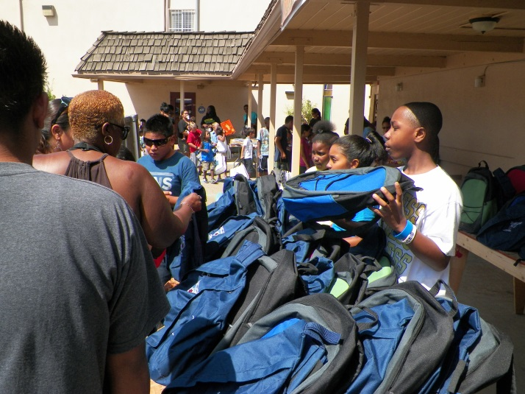
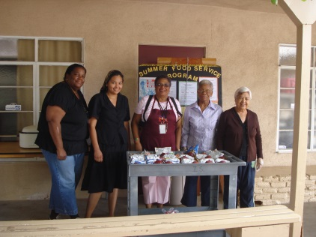
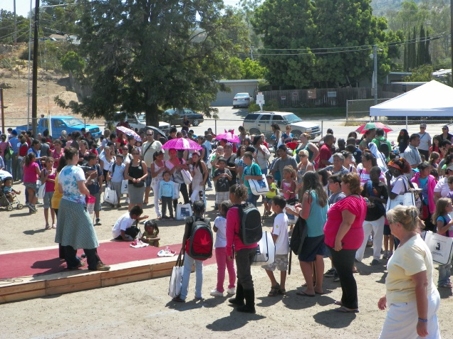
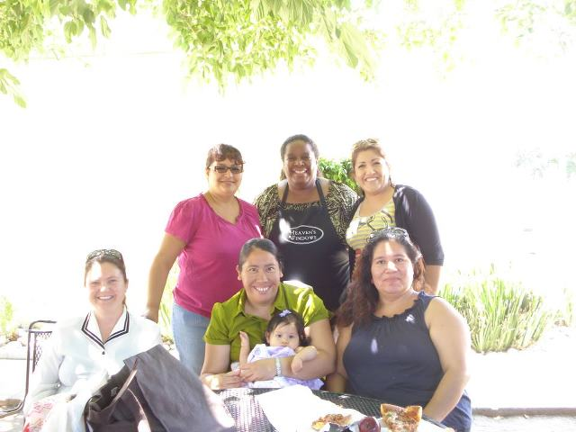
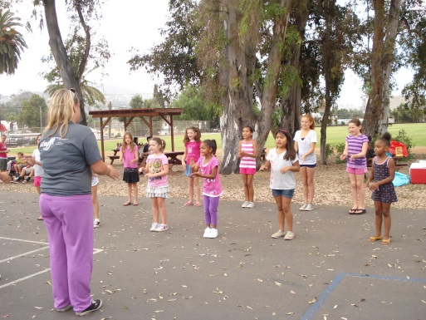
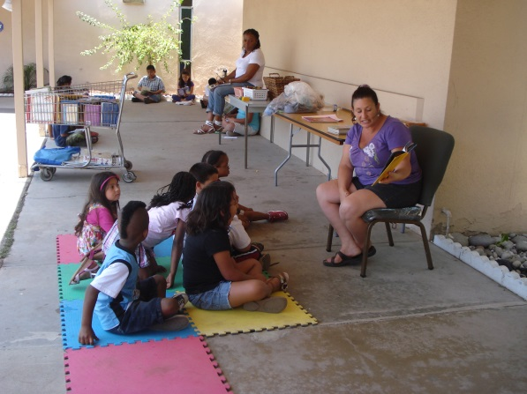
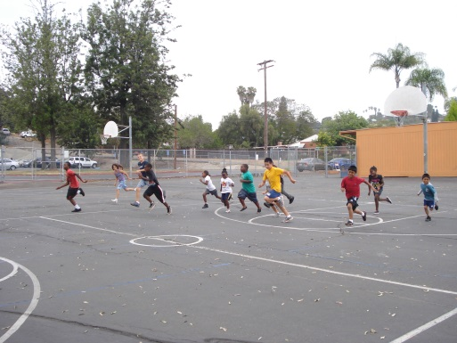
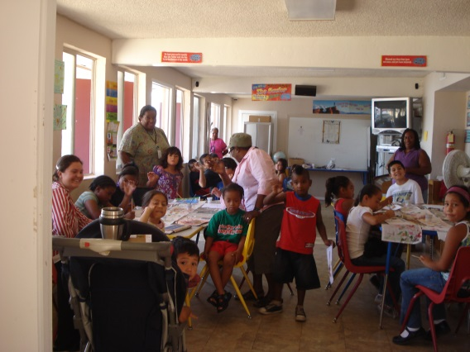
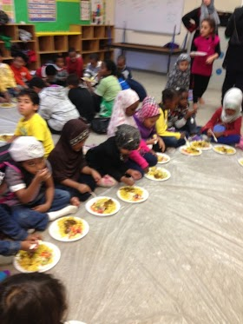

Slide 7
Putting it all together
Finding Sponsor
Volunteer Base
Time and Space
Outreach Plan
Begin Service

Slide 8
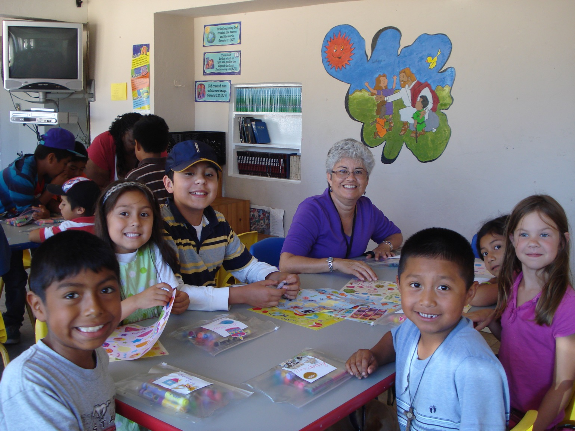
KEEP IT SIMPLE &
HAVE FUN!

