Slide 1

Cities, Schools
& Community Partners:
Working Together to Build Healthy Summers
Patrice Chamberlain
California Summer Meal Coalition

Slide 2
Agenda
Welcome, A Look at the Summer Landscape
Patrice Chamberlain, California Summer Meal Coalition
City of Hayward: A Community-Wide Response to Feeding Kids
Mark Salinas, City of Hayward Council Member
City of Long Beach: Successful Summer Meal Partnerships
Darlene Martin, Long Beach Unified School District
Tamalyn Sayre, City of Long Beach Parks, Recreation, & Marine
City of Oakland: Working with Community Partners
Carmela Chase, City of Oakland Dept. of Human Services
Q + A

Slide 3
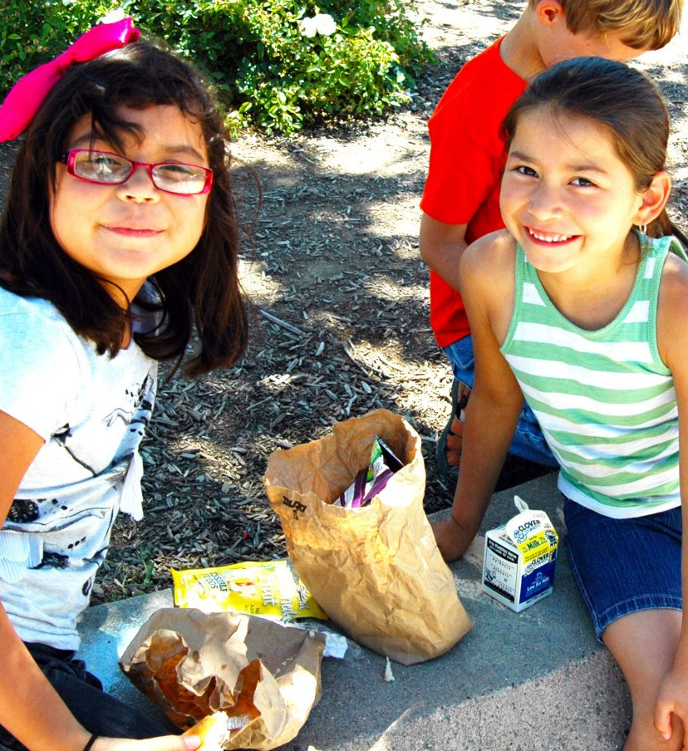
Why does summer matter?
Increasing need for free/reduced-price (FRP) lunch during the school year – need continues in summer
  In CA, only 16% of those receiving FRP lunch participated in a summer meal program
In addition to higher rate of food insecurity, lack of access to healthy food and physical activity in summer adds to risk of childhood obesity
  Kids may gain 2-3x as much weight during summer than during school year
Low-income kids may face greater summer learning loss
Sources: California Food Policy Advocates, 2012; National Summer Learning Association, 2012

Slide 4
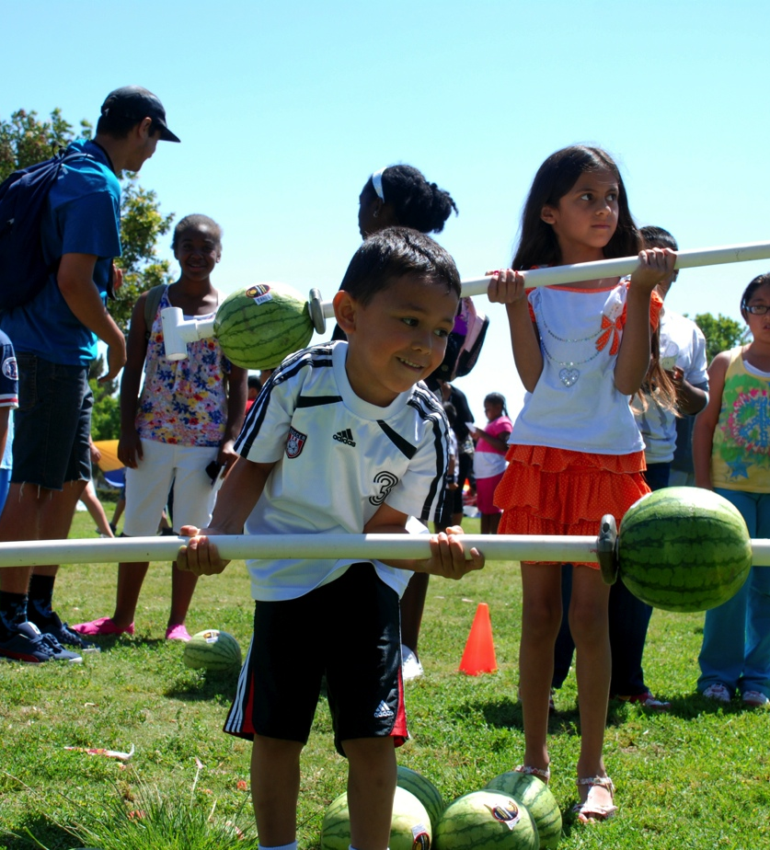
A Vision for Summer
USDA Summer Food Service Program(SFSP) and National School Lunch Program (NSLP) / Seamless Summer Feeding Option (SSFO)
Federally-funded program reimburses school districts and community-based agencies to serve free, healthy meals to kids (up to age 18) in low-income areas when school is out
Summer meal programs offer opportunities:
  Healthy meals
  Nutrition education/physical activity
  Enrichment/learning activities
  Facilitate community partnerships

Slide 5
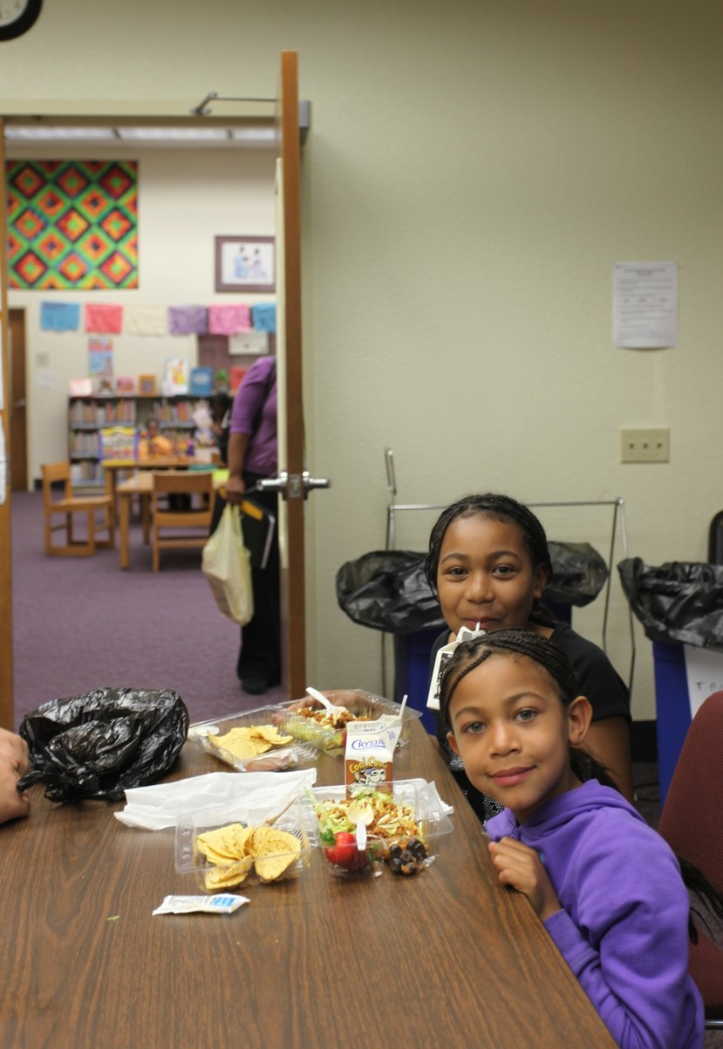
An All Hands On Deck Effort
City Leaders
  Take an active role in your city’s summer strategy; facilitate partnerships; promote local programs…
School Districts
  Become a sponsor or vendor; expand beyond summer school; enhance your program; engage teachers and principals…
Community-Based Agencies/Leaders
  Become a summer meal site; promote summer meal sites in your community; recruit volunteers…

Slide 6
California Summer Meal Coalition
Statewide network brought together to address the summer nutrition gap
A program of the Public Health Institute
Members representing broad group of stakeholders: schools, afterschool programs, CBOs, food banks, food policy & anti-hunger, nutrition/physical activity, state agencies
Thanks to Network for a Healthy California for making our work possible!
Alameda County Comm. Food Bank
California Afterschool Network
California Dept. of Education
California Dept. of Public Health Network for a Healthy California
California Assoc. of Food Banks
California Food Policy Advocates
California School Boards Association
CANFIT
Center for Collaborative Solutions
FIND Food Bank
Food Research & Action Center
Fresno Economic Opportunities Commission
City of Oakland Dept. of Human Services
Partnership for Children & Youth
Redwood Empire Food Bank
Sacramento Hunger Coalition
San Francisco Dept. of Children & Youth
School Districts: Alvord, Bakersfield, Long Beach, Palm Springs, Riverside, San Francisco, Salida, San Diego
YMCA Silicon Valley

Slide 7
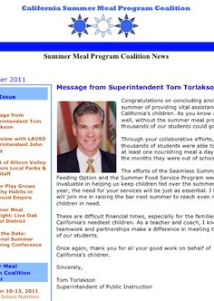
What We do
Webinars
Monthly eNewsletter
Resources, Templates and Tools
Nutrition Education Resources
www.summermealcoalition.org

Slide 8


Contact Information:
Patrice Chamberlain
Director, California Summer Meal Coalition
Public Health Institute
415.637.6815
Patrice.chamberlain@phi.org
CA_SummerMeals
It is easier to build strong children than to repair broken men.
-Frederick Douglass

