Slide 1
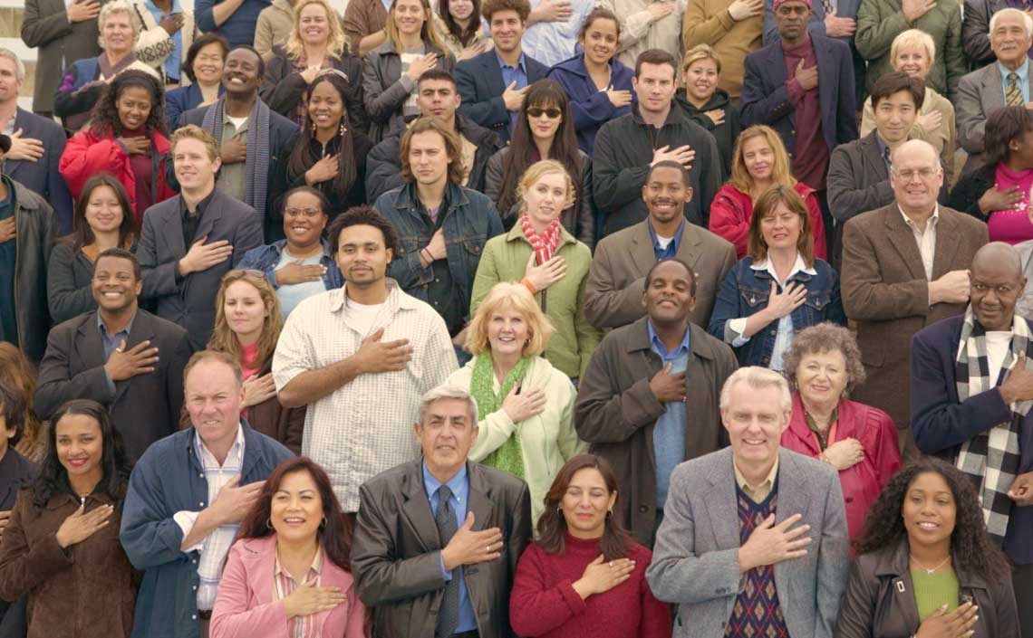
Presentation on the NAC
to the Institute for Local Government

Slide 2
Overview
Three Topics:
How one becomes a US Citizen
Barriers to applying
What the New Americans Campaign (NAC) is doing around Citizenship

Slide 3
Why Naturalization Now?
8.5 million eligible in US
750,000 – 850,000 applying every year
1,000,000 newly becoming eligible every year
2.6 millions eligible in CA
Losing the race
Want people to become fully engaged Americans (feeling of belonging, vote, participate, use libraries and government services, volunteer, higher income, better for economy on the whole, etc.)
Builds our democracy!

Slide 4
Process of Becoming A US Citizen
Most Common ways to become a US Citizen
Birth in US
Naturalization

Slide 5
Naturalization
Naturalization is the process of becoming a US Citizen (USC)
Generally to naturalize one must be a lawful permanent resident (LPR)
- Exception for people in the US military during a time of war (like now, War on Terror)
LPR means you are in the US legally, with permission to live and work in the US permanently (unless you mess up)
This is not about undocumented residents or immigration reform

Slide 6
Requirements for Naturalization
Lawful Permanent Residence for 5 Years (3 years if married to USC)
18 years or older
Physically present in US at least half of those 5 years
Good Moral Character for last 5 years
Pass an English reading, writing, and speaking test (exceptions apply)
Pass a US government and history test (exceptions apply)
Take an oath of allegiance to US

Slide 7
Barriers to Naturalization
English Language (waivers exist for age and disability)
Fees - $680 (waiver for very low income)
Good Moral Character
Complicated application process – 10 page form going to be 20 and 10 pages of instructions
Need help

Slide 8
New Americans Campaign (NAC)
Innovative National Campaign with goals of:
Increasing the number of people who apply for naturalization
2. Building capacity for naturalization

Slide 9
Who is in the NAC?
Collaboration of:
Over a dozen of national and local funders
9 national NGOs
More than 50 local NGOs
Communication and evaluation teams

Slide 10
With whom does NAC Partner?
Government (local, state, and federal)
Elected representatives
Libraries
Schools
Business
Faith groups
Etc.

Slide 11
Where is the NAC?
California:
San Diego, Orange County, LA, Santa Clara/San Mateo Counties, SF, and East Bay (Contra Costa and Alameda Counties)
Working with naturalization efforts in Central Valley, Inland Empire, and Napa as well
Nationally:
NY, Miami, Detroit, Charlotte, Dallas, Houston, IL, Washington State, Maryland, MA

Slide 12
What is the NAC doing?
Impact
- Helped 68,000+ people complete applications
- Helped more than 8,300 apply for fee waiver
- Saved community nearly $6,000,000 in fees to reinvest in community business
Collaboration – A structure for the work
- Each site has a collaboration, with a site leader
- Joint activities = leverage resources and more productive

Slide 13
What is NAC doing?
Innovation – Remake the way we help people naturalize
- Technology (Apps for smart phones, website with interactive US government and history learning and interactive application assistance)
- Public-Private Partnerships
Diversity – Work with immigrants from all over the world

Slide 14
We need your help - big or small
Resources
Funding
Outreach
Facilities
Support
Encouragement

Slide 15
Thank you!
Eric Cohen, Executive Director
Immigrant Legal Resource Center
ecohen@ilrc.org
415-255-9499 x264

