Slide 1
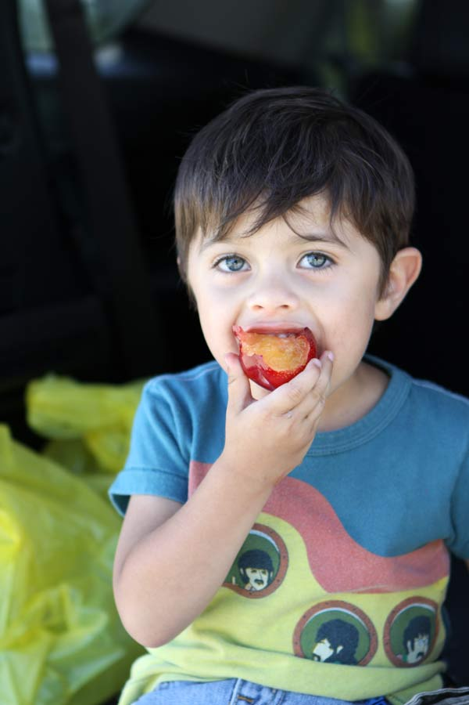

Lifting up Our Communities: Strategies for Faith Leaders to Keep Kids Healthy When School’s Out
Patrice Chamberlain
Director, California Summer Meal Coalition

Slide 2

Agenda
Introduction to Summer Meals
Patrice Chamberlain,
Director, California Summer Meal Coalition
Faith-Based: Why Not?
Angela Kretschmar
Executive Director, Heaven’s Windows / A.B. Vines Ministries
Lifting Up Our Communities: Empowering Impoverished Neighborhoods to Thrive
Monika Grasley
Executive Director, Lifeline Community Development Corp.
Q & A w/ speakers and Dennis Arena, CA Dept. of Education

Slide 3
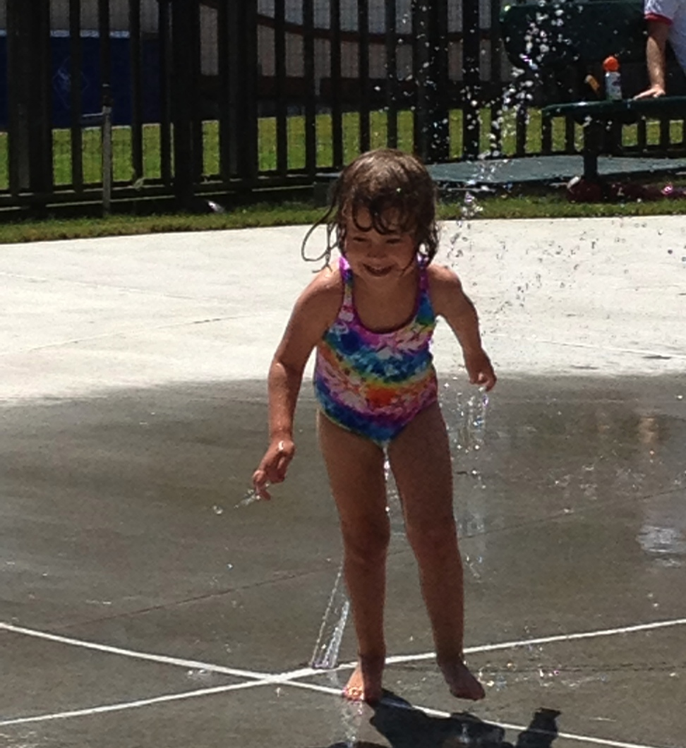
A Vision for Summer
What is it that we want summer to be for kids?
What does summer currently look like for low-income kids in your community?
How can we re-envision summer so that kids are healthy, active, and engaged?

Slide 4
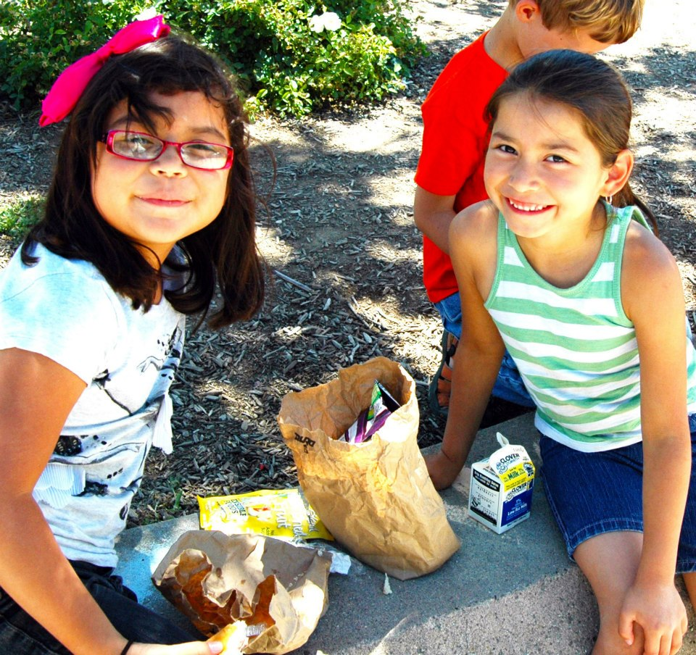
Why does summer matter?
Recession brought increased need for free/reduced-price (FRP) lunch during the school year – need continues in summer
In CA, in 2011,only 16% of those receiving FRP lunch participated in a summer meal program
Food insecurity associated with developmental, cognitive, behavioral and physical issues
  May be linked to lower academic gains
Sources: California Food Policy Advocates, 2012; Leadership for Healthy Communities, 2012

Slide 5
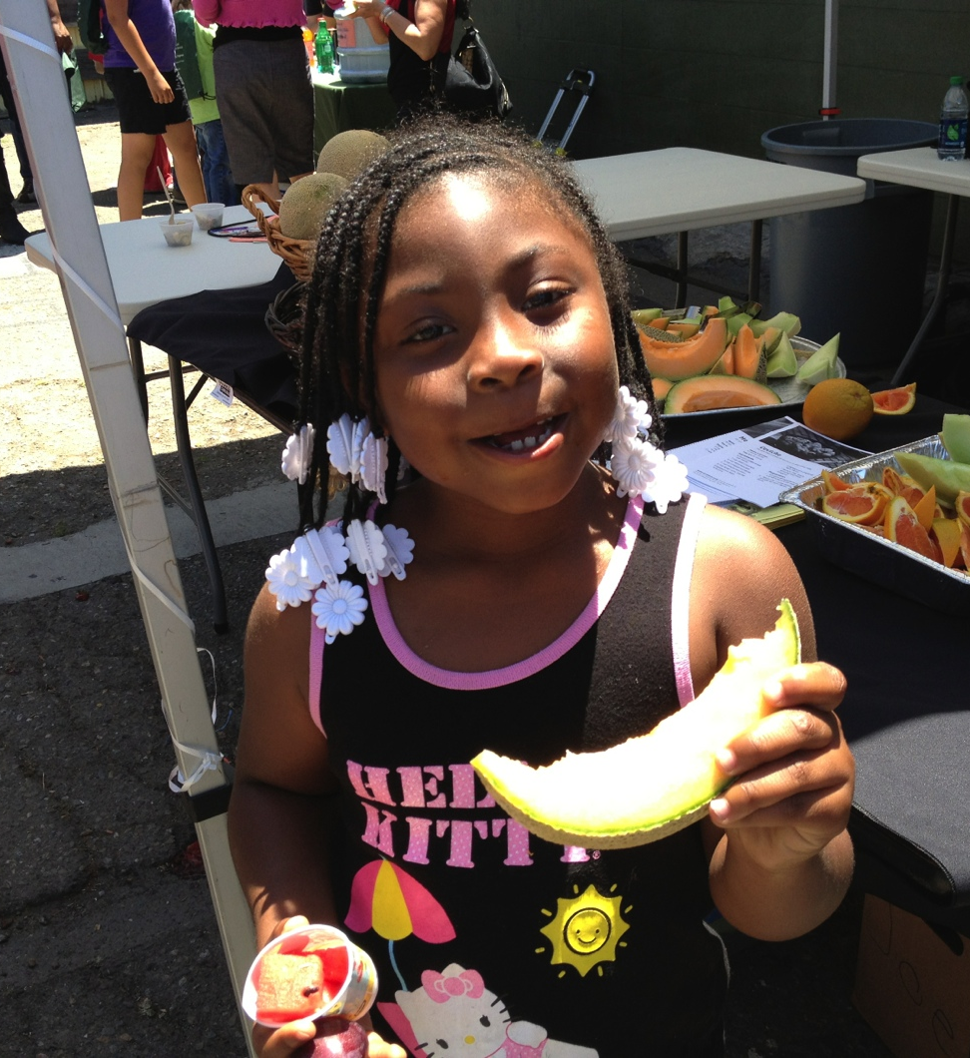
Why summer matters (cont.)
In addition, lack of access to healthy food and safe places to play may increase risk of childhood obesity
  Kids may gain weight 2-3x faster during the summer than during the school year
  Failure to include summer in obesity prevention efforts can undermine school-year efforts
Low-income kids may experience greater summer learning loss than more affluent peers
Source: National Summer Learning Association, 2012

Slide 6
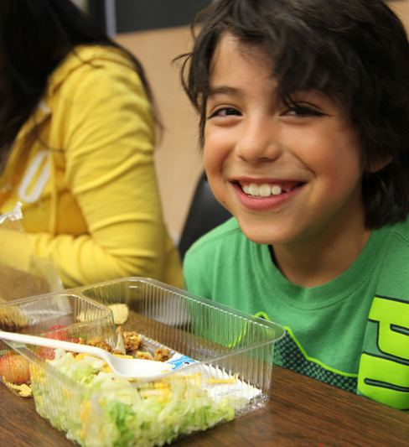
USDA Summer
Nutrition Programs
USDA Summer Nutrition Programs = opportunity to stop nutrition gap left by school’s closure in summer
  School districts, units of local or county government, tribal governments or nonprofits can provide free, nutritious meals to children 0-18 in low-income neighborhoods
  A “sponsor” works with community partner sites that serve low-income children to provide meals

Slide 7
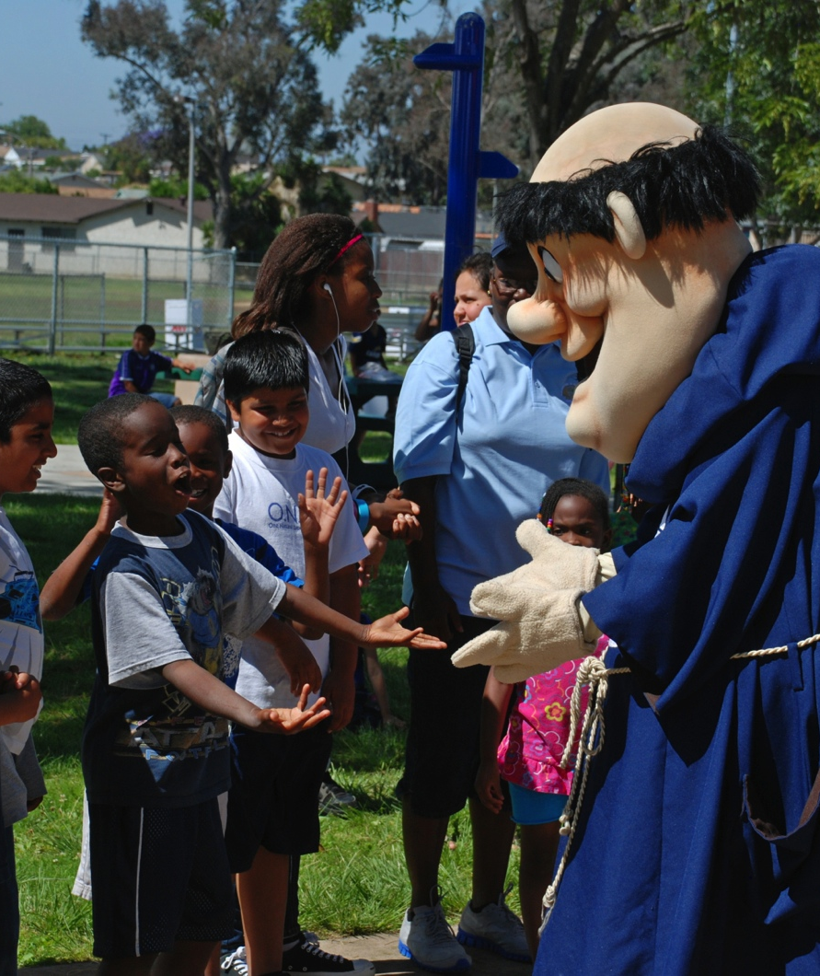
How can summer meals help low-income families?
Summer meals help families stretch limited budgets
  Most families report spending more money on food in summer
  Summer is the busiest time for food banks
Community summer meal sites provide a safe environment for kids
  Supervised
  Can provide fun activities
  No proof of income or paperwork needed
  Can help connect families with other community resources…and other families

Slide 8
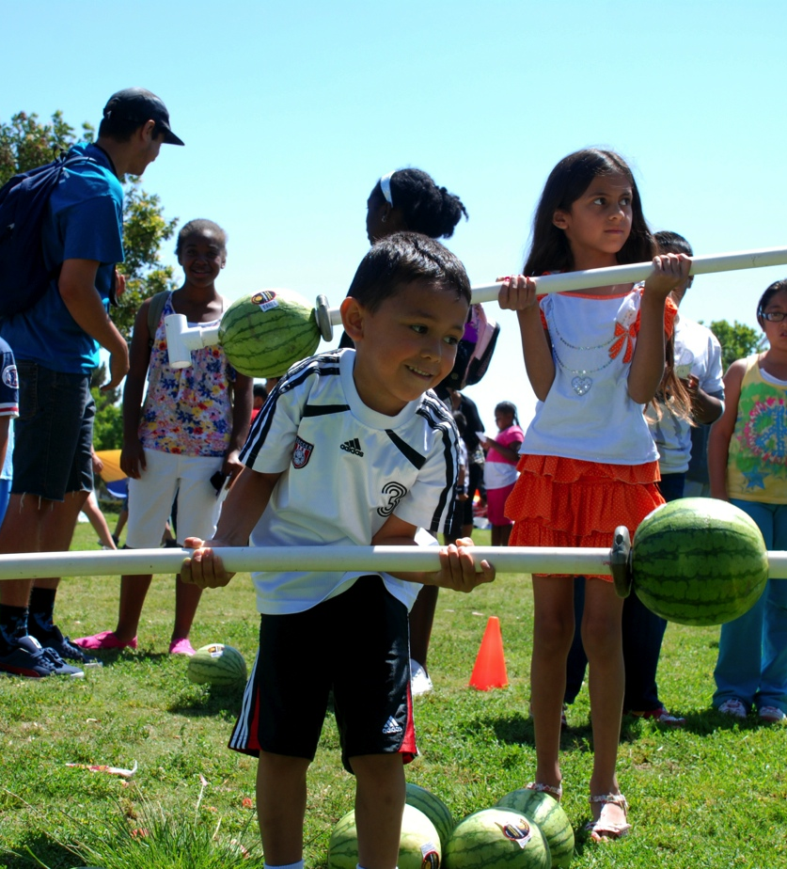
The community opportunity
Summer meal programs offer possibilities:
  Free, healthy meals
  Nutrition education/physical activity
  Enrichment/learning activities
  Facilitate community partnerships
Provide the “glue” to building successful and sustainable community partnerships to support low-income children and their families

Slide 9
How can the faith community help?
Find out if your organization can become a summer meal site.
Promote local summer meal sites.
Provide volunteers.

Slide 10
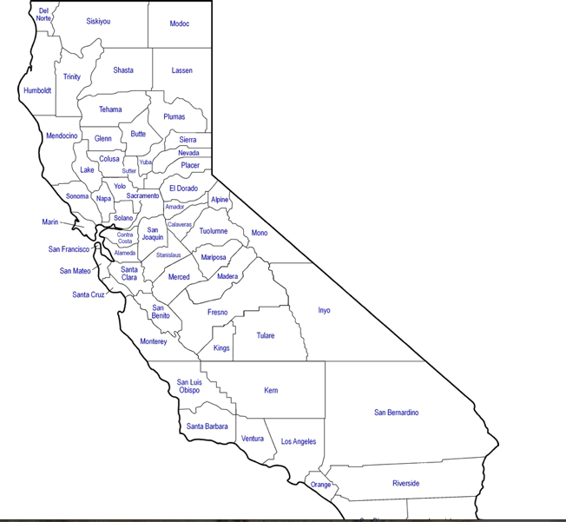
CDE Summer Meal
Site List
California Department of Education (CDE) map of 2012 summer meal sponsors and sites
Visit www.summermealcoalition.org and click on “Find Summer Meals”
2013 CDE map not yet complete
Can contact local school district child nutrition department or contact 2012 sites
Contact the Summer Meal Coalition if you need help!

Slide 11
California Summer Meal Coalition
Statewide network brought together to combat childhood obesity and food insecurity by increasing access to USDA summer meal programs
Members representing broad group of stakeholders: schools, afterschool programs, CBOs, food banks, food policy & anti-hunger, nutrition/physical activity, state agencies
www.summermealcoalition.org
Thanks to Network for a Healthy California, FRAC and the David & Lucile Packard Foundation for making our work possible!
Alliance for a Healthier Generation
Alameda County Community Food Bank
California Afterschool Network
California Dept. of Education
California Dept. of Public Health Network for a Healthy California
California Assoc. of Food Banks
California Food Policy Advocates
California School Boards Association
CANFIT
Center for Collaborative Solutions
FIND Food Bank
Food Research & Action Center
Fresno Economic Opportunities Commission
City of Oakland Dept. of Human Services
Partnership for Children & Youth
Redwood Empire Food Bank
Sacramento Hunger Coalition
San Francisco Dept. of Children & Youth
School Districts: Alvord, Bakersfield, Long Beach, Riverside, San Francisco, Salida, San Diego
San Diego Summer Lunch Task Force
YMCA Silicon Valley

Slide 12


Contact Information:
Patrice Chamberlain
Director, California Summer Meal Coalition
Public Health Institute
415.637.6815
Patrice.chamberlain@phi.org
CA_SummerMeals
It is easier to build strong children than to repair broken men.
-Frederick Douglass
This webinar is produced with support from the California Department of Public Health’s Network for a Healthy California with funding from USDA SNAP, known in California as CalFresh (formerly Food Stamps). These institutions are equal opportunity providers and employers. CalFresh provides assistance to low-income households and can help buy nutritious foods for better health. For CalFresh information, call 1-877-847-3663. For important nutrition information, visit www.cachampionsforchange.net

