Slide 1


Technology, Tools and Techniques to Improve
Public Engagement
ILG Webinar
June 18, 2014
10:00am – 11:00am

Slide 2
Speakers
Director, Common Knowledge
Consultant, Regional Government Services
Brian Moura
Susan Stuart Clark
Moderator: Christal Love Lazard,
Public Engagement Program, ILG

Slide 3
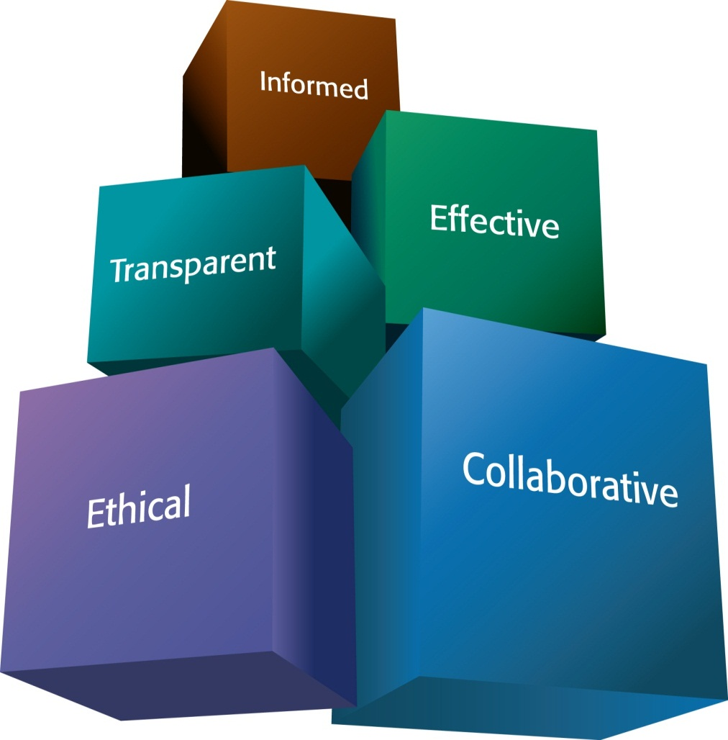
ILG Mission
Promoting good government at the local level
Practical, impartial and easy-to-use materials
Notes:
The Institute for Local Government promotes good government at the local level with practical, impartial and easy-to-use resources for California communities. ILG’s resources are in many areas including ethics, collaboration, public engagement and sustainable communities. ILG is the research and education affiliate of the California State Association of Counties and the League of California Cities.

Slide 4
A Brief Overview Of Tools To Consider
Website
Social Media
Blogs and
e-newsletters
Local Agency TV channels
Online Surveys
Open Data
Code for America
Crowdsourcing
Mobile Apps

Slide 5
Polling Question

Slide 6

CK
Broadening Public Participation
with Technology
Institute for Local Government
June 18, 2014 Webinar
Susan Stuart Clark

Slide 7
Why
Why broaden participation in local decision making
What
What types of online decision input tools are agencies using
How
How to implement to enhance outcomes

Slide 8
2013 Research with CA Public Officials | City | County
Public meetings are dominated by people with narrow agendas. | 76% | 77%
Community members have become more angry and mistrustful. | 68% | 78%
Testing the Waters, May 2013 report with findings from 900 California local officials.

Slide 9
County Board / City Council
Staff
Planning Commission
Other Boards & Commissions
Directly Affected Residents
Experts
“Professional” Citizens
Advocates
Service Providers
“Quiet” Public
Notes:
For a city-wide or county-wide discussion

Slide 10
Benefits of Digital Engagement
Reach more diverse residents
More informed participation
Invite broader range of perspectives
Concrete data for reporting and evaluation
Notes:
WILL PAUSE to ask which of these benefits is most compelling to members of the audience; any others? also note questions sent ahead:
1) Traditional engagement methods usually only touch a small slice of the population. Has digital engagement demonstrated success in reaching out to the broader population that rarely/never participates in local government?

Slide 11
Public Decision-Making Process
Shared
Understanding
of Key Issues
Expand Perspectives/Options
Review Choices/Trade-offs
Community
Meetings & Workshops
Online
Consultation
Public
Hearings
Council
Meetings
Revised Plan/
Options
Draft Plan or
Ordinance
Policy
Decision
Notes:
People need a “you are here” marker.

Slide 12
Choosing Online Engagement Tools
Purposes drive selection of tools:
Inform | Consult | Involve | Collaborate | Empower
Web pages E-notify Videos/podcasts Simulations | Survey/poll Invite feedback E-comment (& comment on others’ comments) | Ideation Trade-offs Mapping Online forum | Interactive community planning Hackathon Ideajam | Citizens report and use data Neighbor to neighbor apps

Slide 13
Local Government Examples
Planning/Transportation
Strategic Planning/Budgeting
Specific
Policies
Quality
of Life
Notes:
Sarah – I changed the colors just so people would not confuse with slide 5.

Slide 16
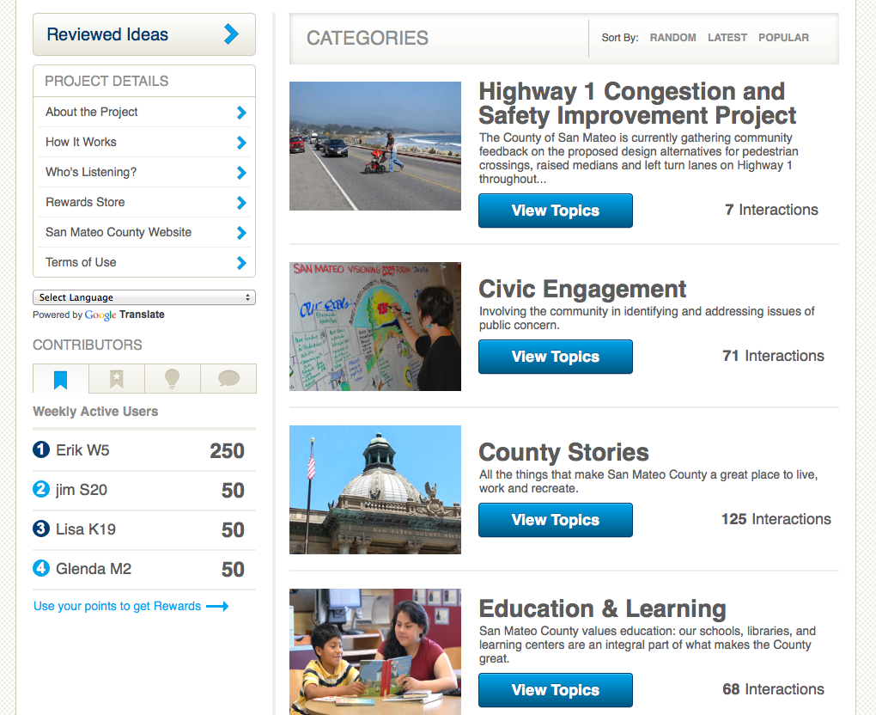

Slide 17
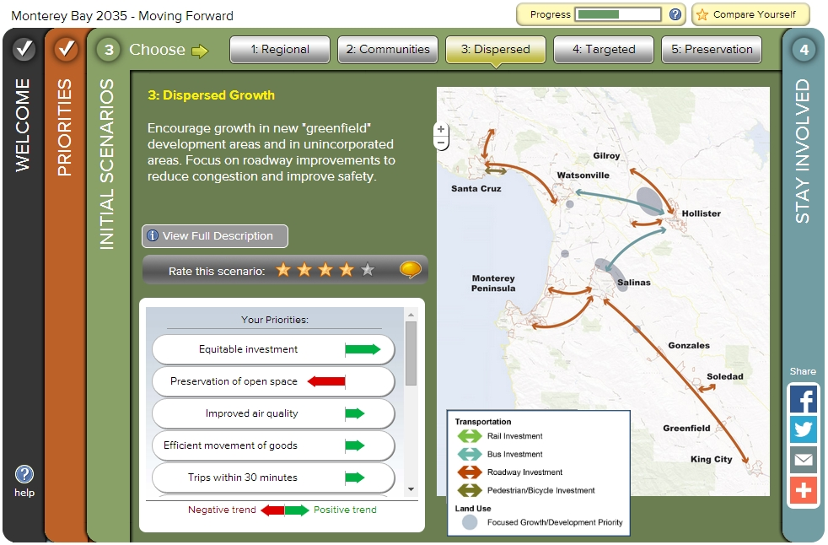
AMBAG Long Range Transportation Plan

Slide 18
Effective Use of Online Engagement
1 - Let Purpose Drive Tool
2- Understand Staffing Needs
3 – Outreach Strategy
4 – Community Oriented Info
Clarify needed staff capacities -- plus audience, outreach, information strategy
Announce digital interface via multiple platforms/partners; seed the conversation
Define engagement purpose, how input will be used and outcomes shared
Use online setting to provide visual information, tiered for different audiences
Adopt a “learning attitude” for continuous improvement
Notes:
How do we find a way to balance the weight given to an electronic comment compared to in person testimony? is there a good way that someone has found useful?
4) With digital engagement, what has been the response from communities that may not have the access and means to engage?

Slide 19
Thank you
for your public service!!
Susan Stuart Clark
ssclark@ckgroup.org
www.ckgroup.org

Slide 20

Improving Public Engagement
Technology, Tools & Techniques
Brian Moura
Local Government Consultant
Regional Government Services
bmoura8@Comcast.net
June 18, 2014

Slide 21
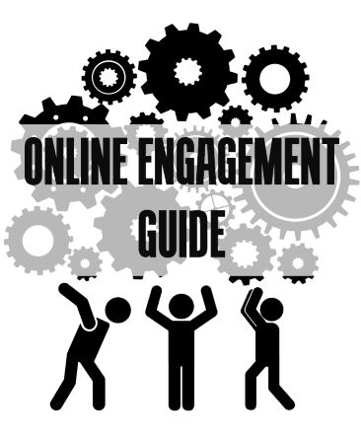
Improving Public Engagement
Essential part of local gov
  New programs & projects
  Proposed developments
  Budget & General Plan
How do we engage public?
  New technologies & tools
  Being “multichannel”
  Linking sources to events
  Things you already own
  Working as a team

Slide 22
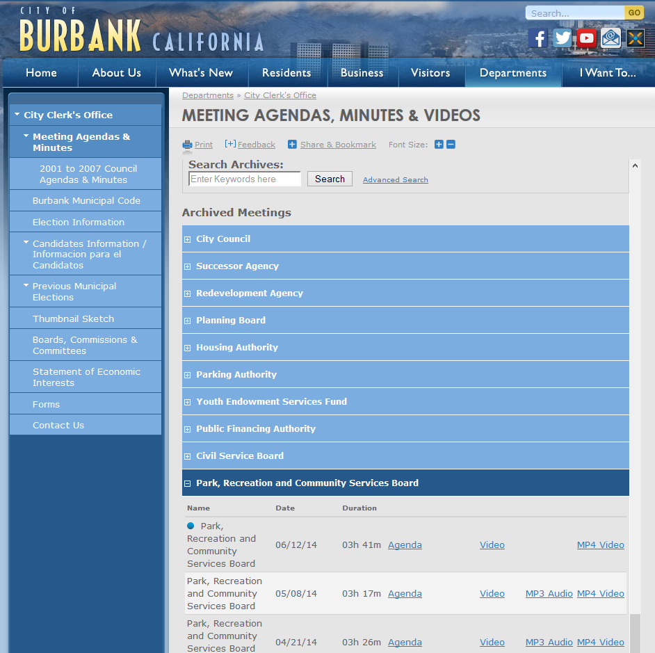
Providing Information
Tools & Technologies
  City/County Web Site
  Document Mgmt System
  City TV Channel, You Tube
Things to Consider
  “Go to” place for all info
  Create sections for proposals
  Calendar of Meetings/Events
  Post all Agendas + Materials
  Meeting videos + clips

Slide 23
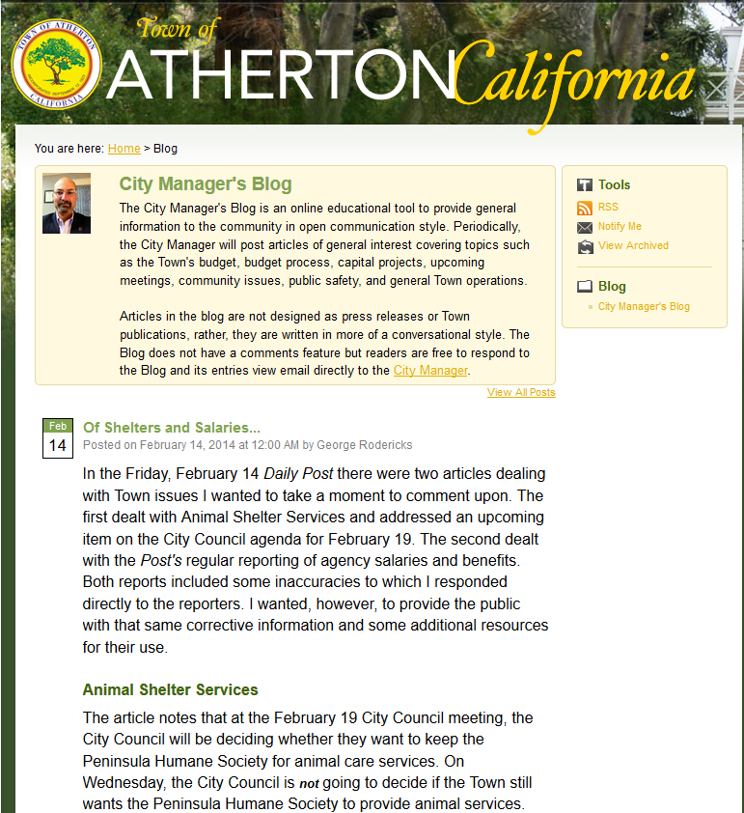
Getting the Word Out
Tools & Technologies
  Email Lists
  Newsletters
  Facebook, Twitter, Blogs
Things to Consider
  Notify: meetings & workshops
  Inform & Tell the story
  Calendar of Meetings/Events
  Direct public to Web Site & Document Mgmt. for details

Slide 24
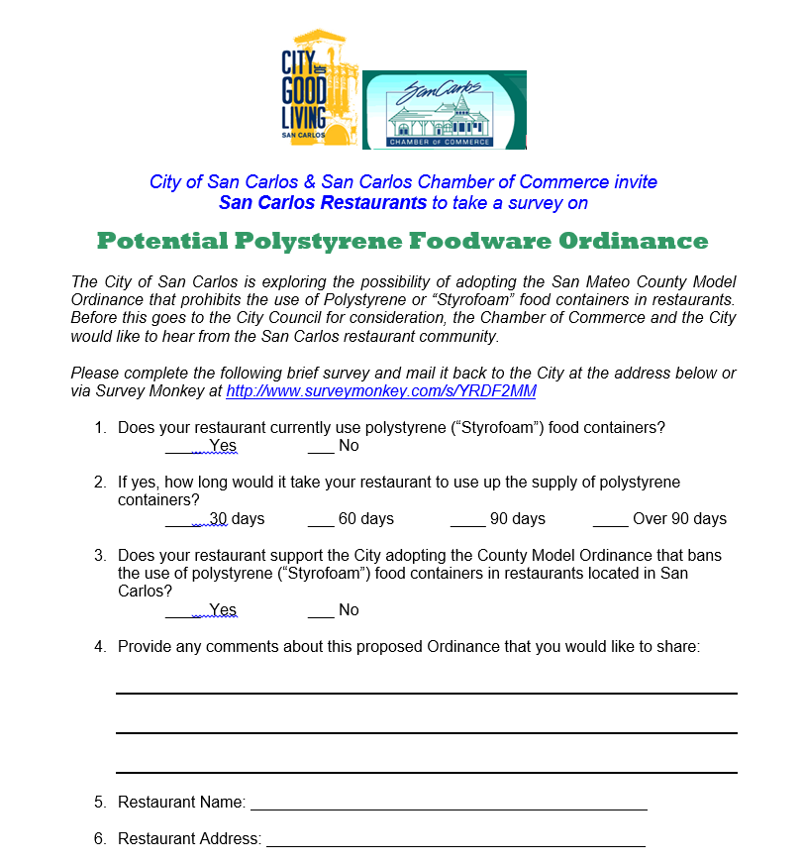
Inviting Public Input & Comments
Tools & Technologies
  Email links & addresses
  Web Survey Software
  Online Forums & Ideas
  Participatory Budgeting
Things to Consider
  Goal: Gather ideas & input
  Email address for comments
  Survey software can be used for input forms
  Budget simulations – with tech or not – can bring more input

Slide 25
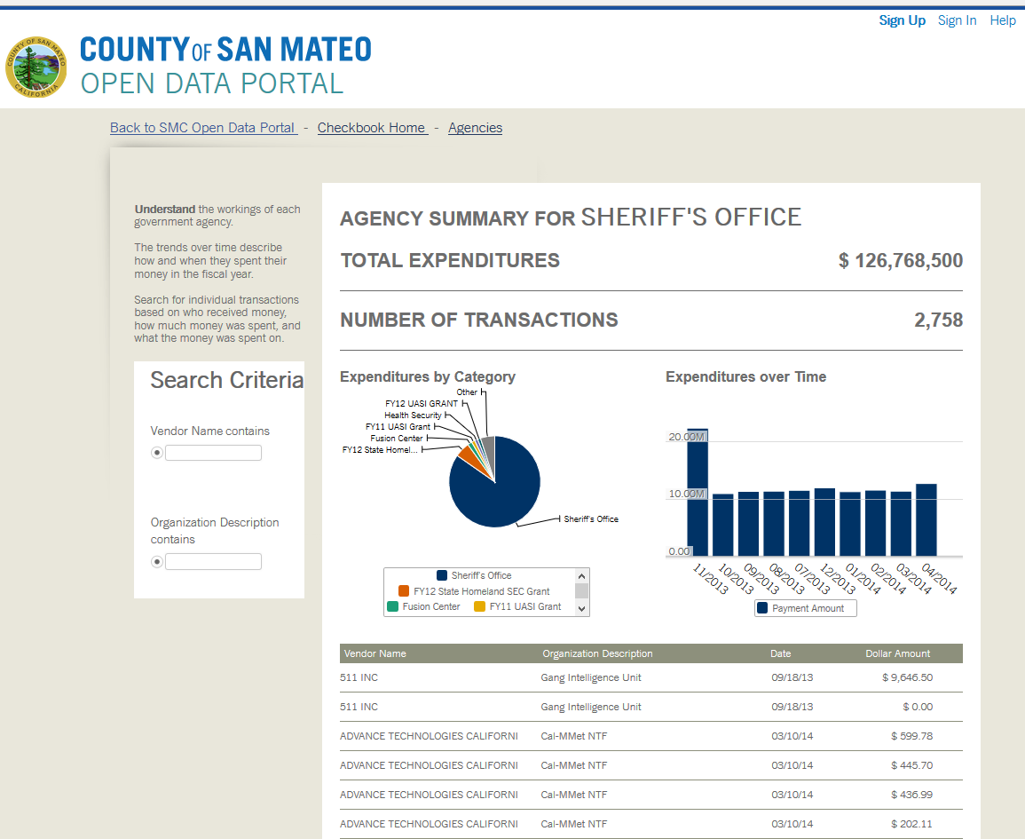
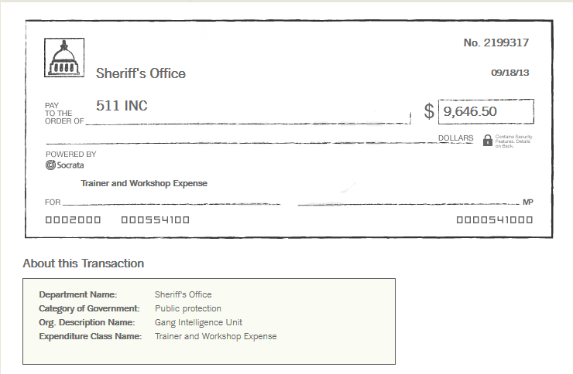
Emerging Technologies
Tools & Technologies
  Creating Apps & Magazines
  Open Data & Viewers
  HD Video, HDR & Beyond
Things to Consider
  Convert info into apps & mags
  Briefing book for General Plan
  Video “pops” with new tech
  Open Checkbook tells public vendors paid, money spent

Slide 26
Questions & Answers

Slide 27

ILG Public Engagement and Technology Resources
Publications, tools and case story examples available here:
http://www.ca-ilg.org/public-engagement-technology
Notes:
I think it is ok to show this image more than 1 time in hopes that people remember it.

Slide 28
Thank You!
The webinar recording will be available on ILG’s website shortly
If you have additional questions please contact Melissa mkuehne@ca-ilg.org

