Slide 1
Lifting up our communities – “Empowering Impoverished Neighborhoods to Thrive”
Monika Grasley

Slide 2

“Everyone no matter how rich has a need. Everyone no matter how poor has a gift. That is why we build and celebrate community.”

Slide 3
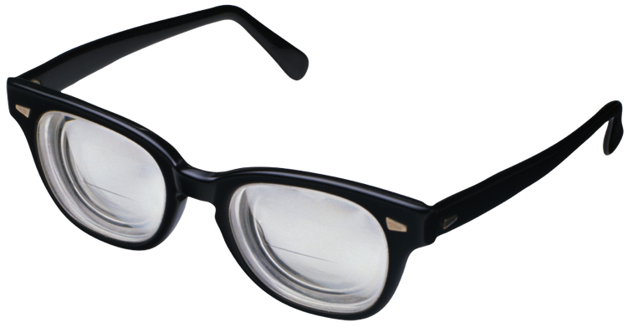
Asset Based Community Development
x
Question
Answer
Wants
Needs
Mobilize Assets
Services
Consumers
Citizens

Slide 4
Poverty Alleviation…
“…is the ministry of reconciliation: moving people closer to glorifying God by living in right relationships with God, with self, with others, and with the rest of creation.”
When Helping Hurts

Slide 5
The Beginning
We did not come in with a program!
Engaged WITH neighbors
Observed Merced City School District Summer Lunch Program
Spoke with neighbors to find out what they wanted
Partnered with the apartment manager to engage the kids in activities after lunch

Slide 6
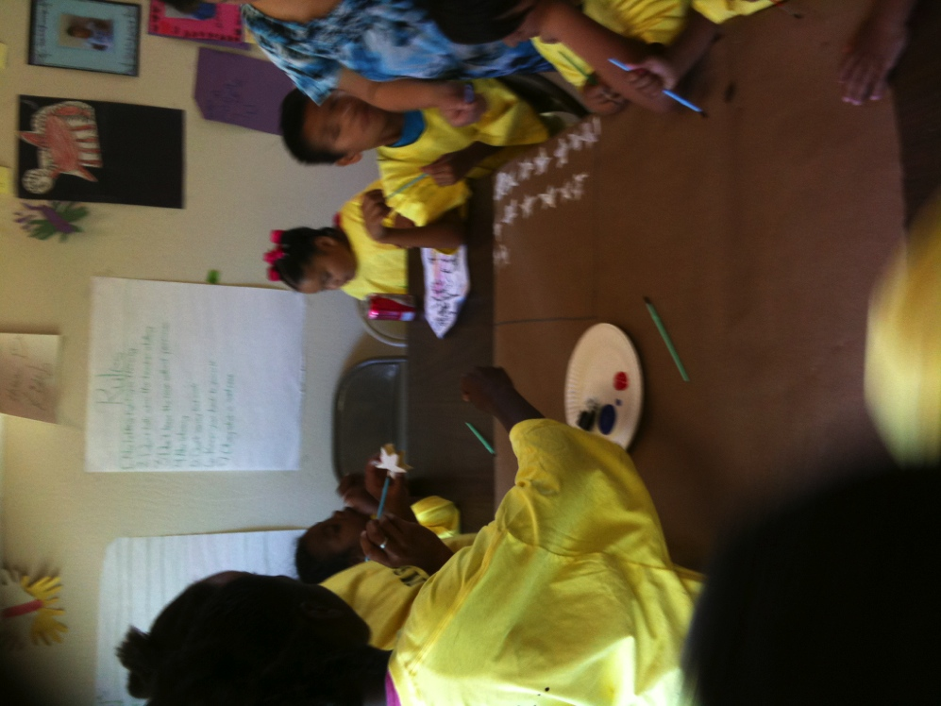
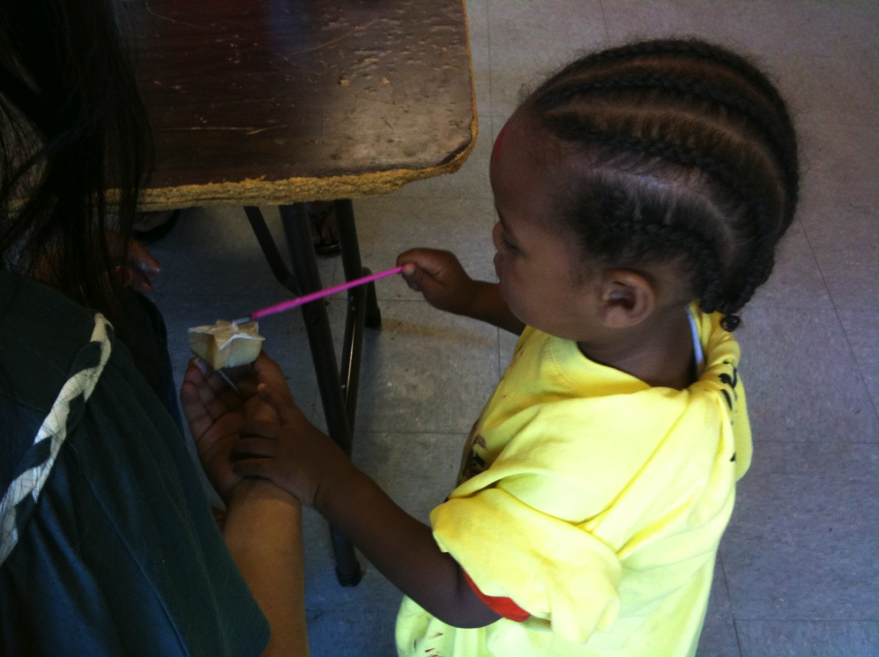
1st year
Getting to know the neighbors
Inside and outside activities that did not cost anything to the families

Slide 7
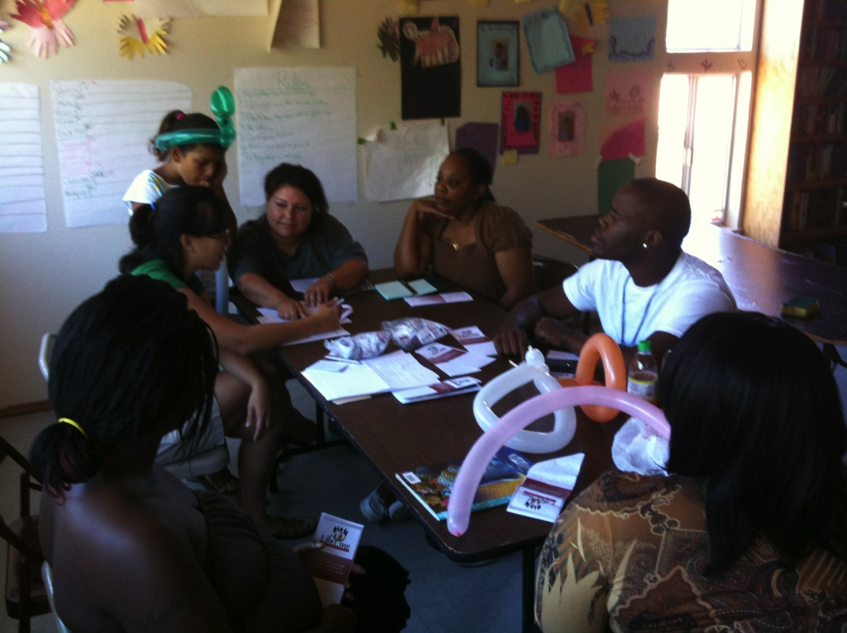
Working WITH the Community
Have community members take ownership
Let them be part of the solution

Slide 8
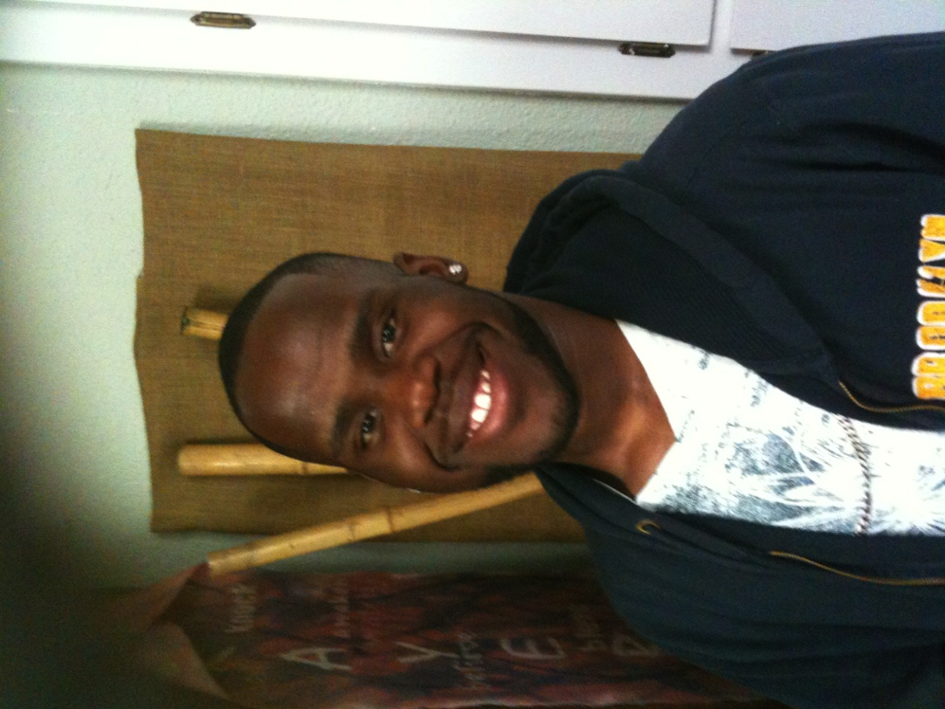
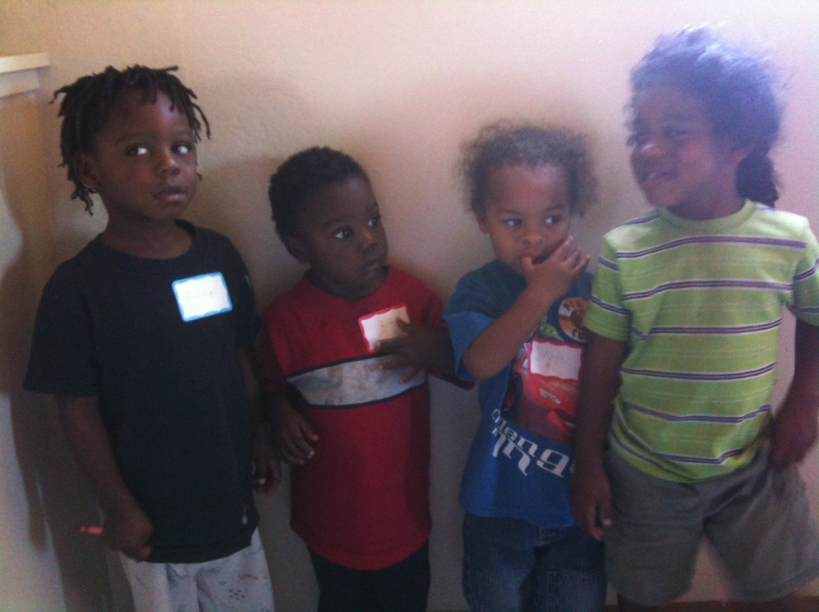
Community Organizer

Slide 9
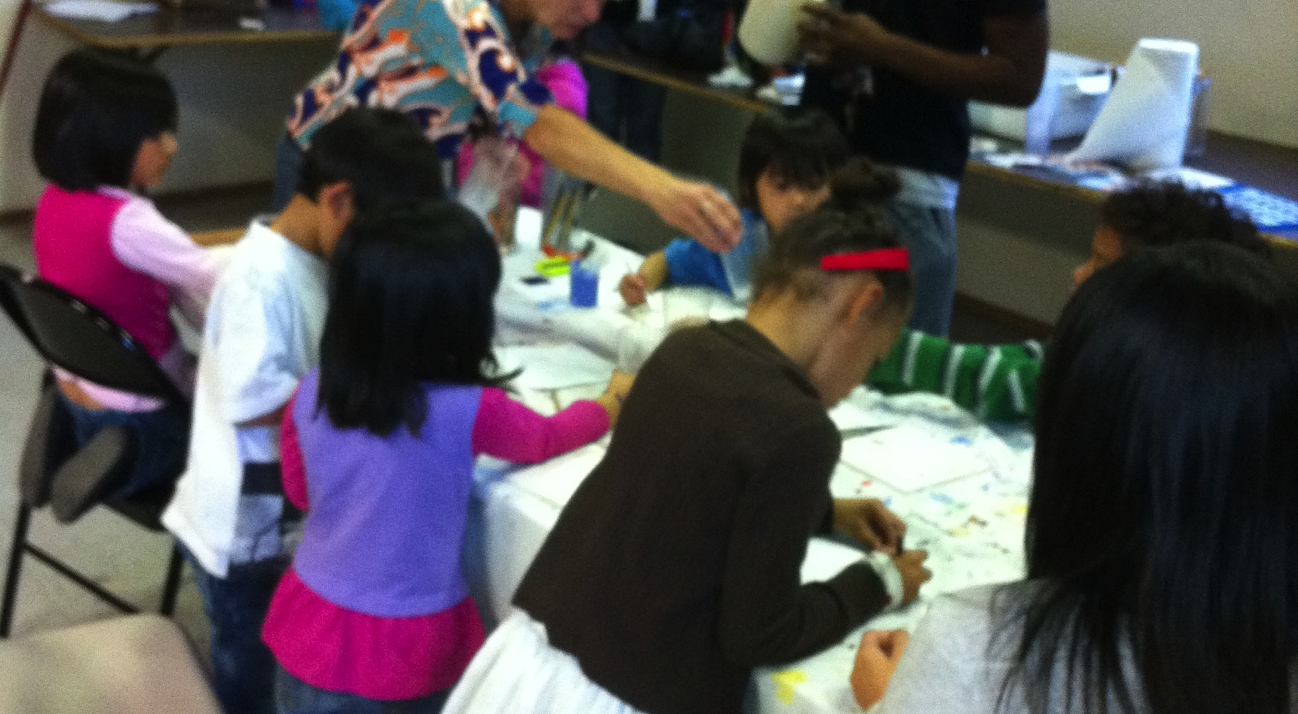
2nd year

Slide 10
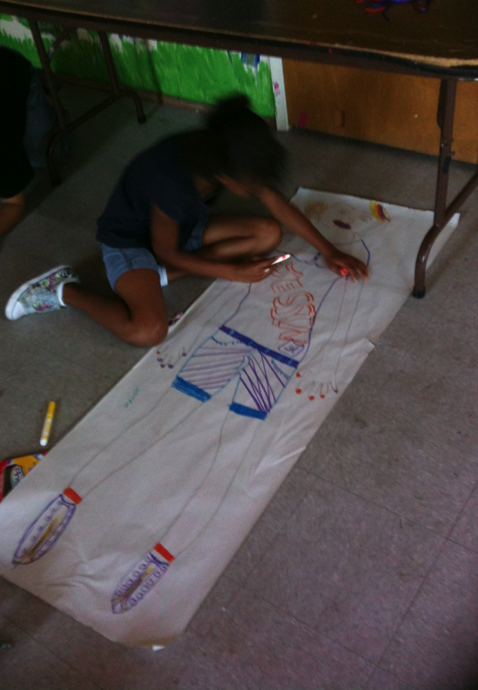
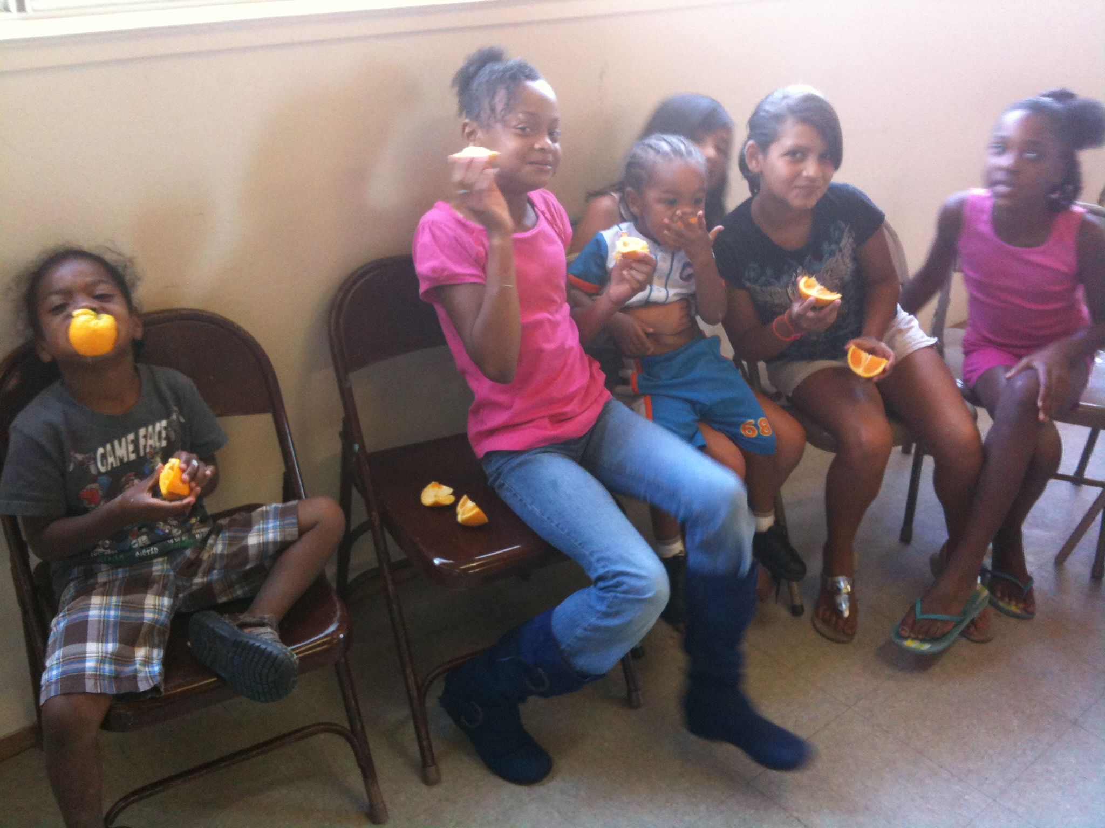
Lunch Coordinators
Reliable and consistent team of people
Loving the community for who they are
Were trained by the District

Slide 11
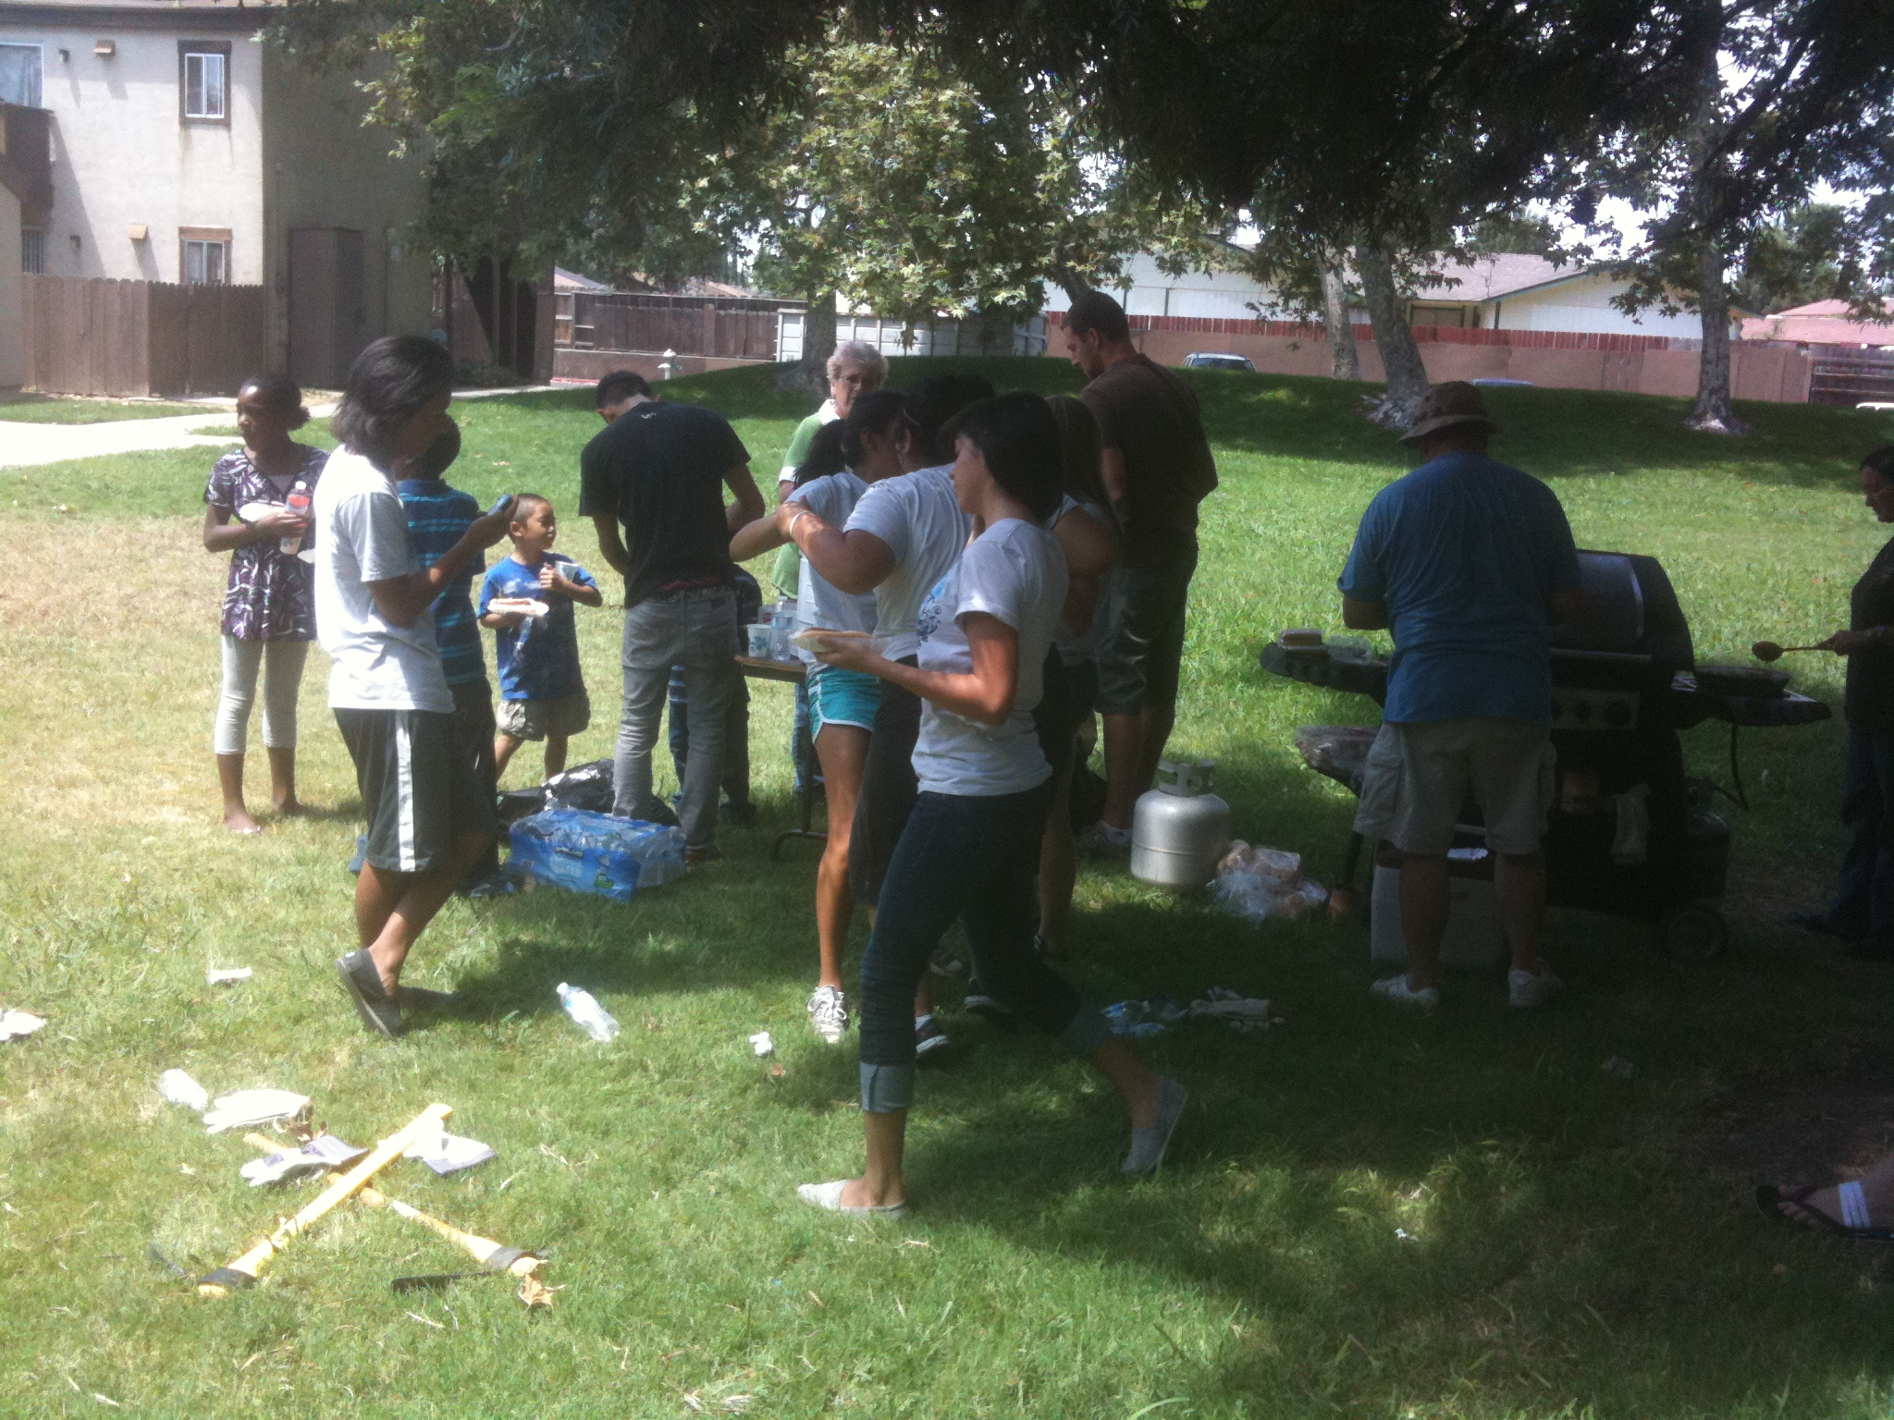
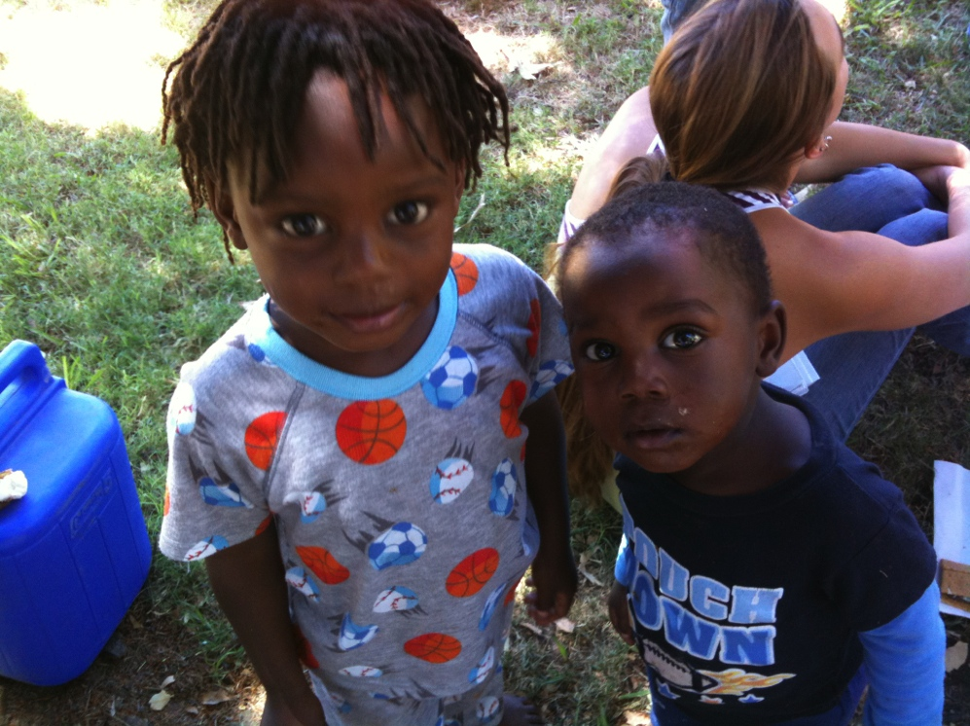
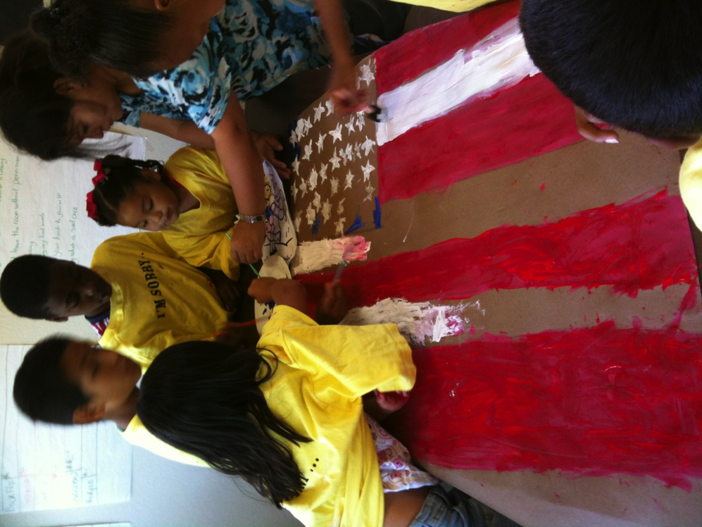
Discovering what people care about
Every person has a gift – how do we help them find it?

Slide 12
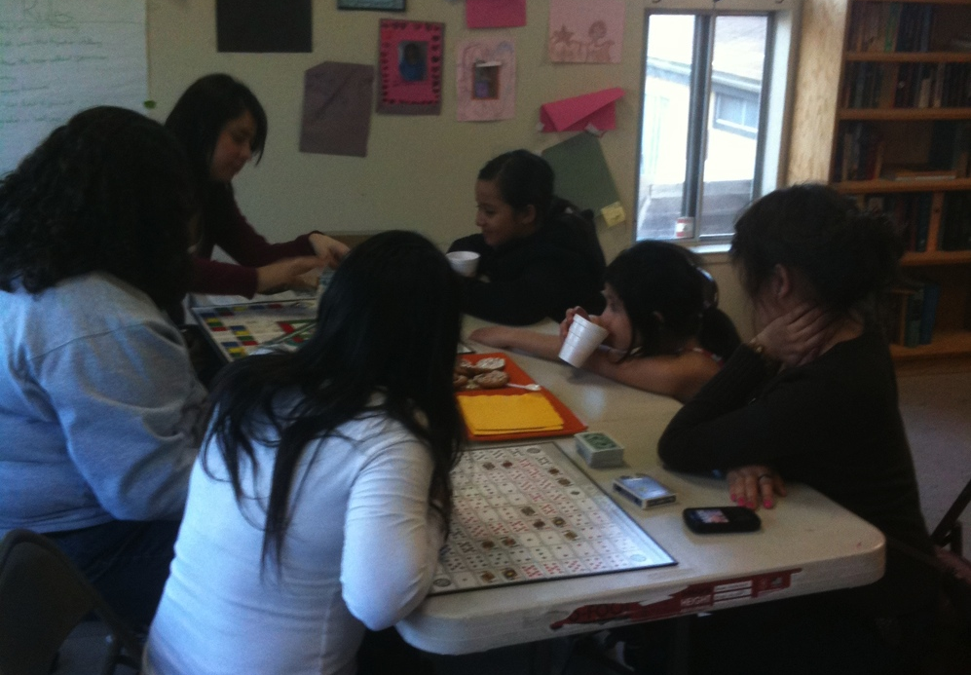
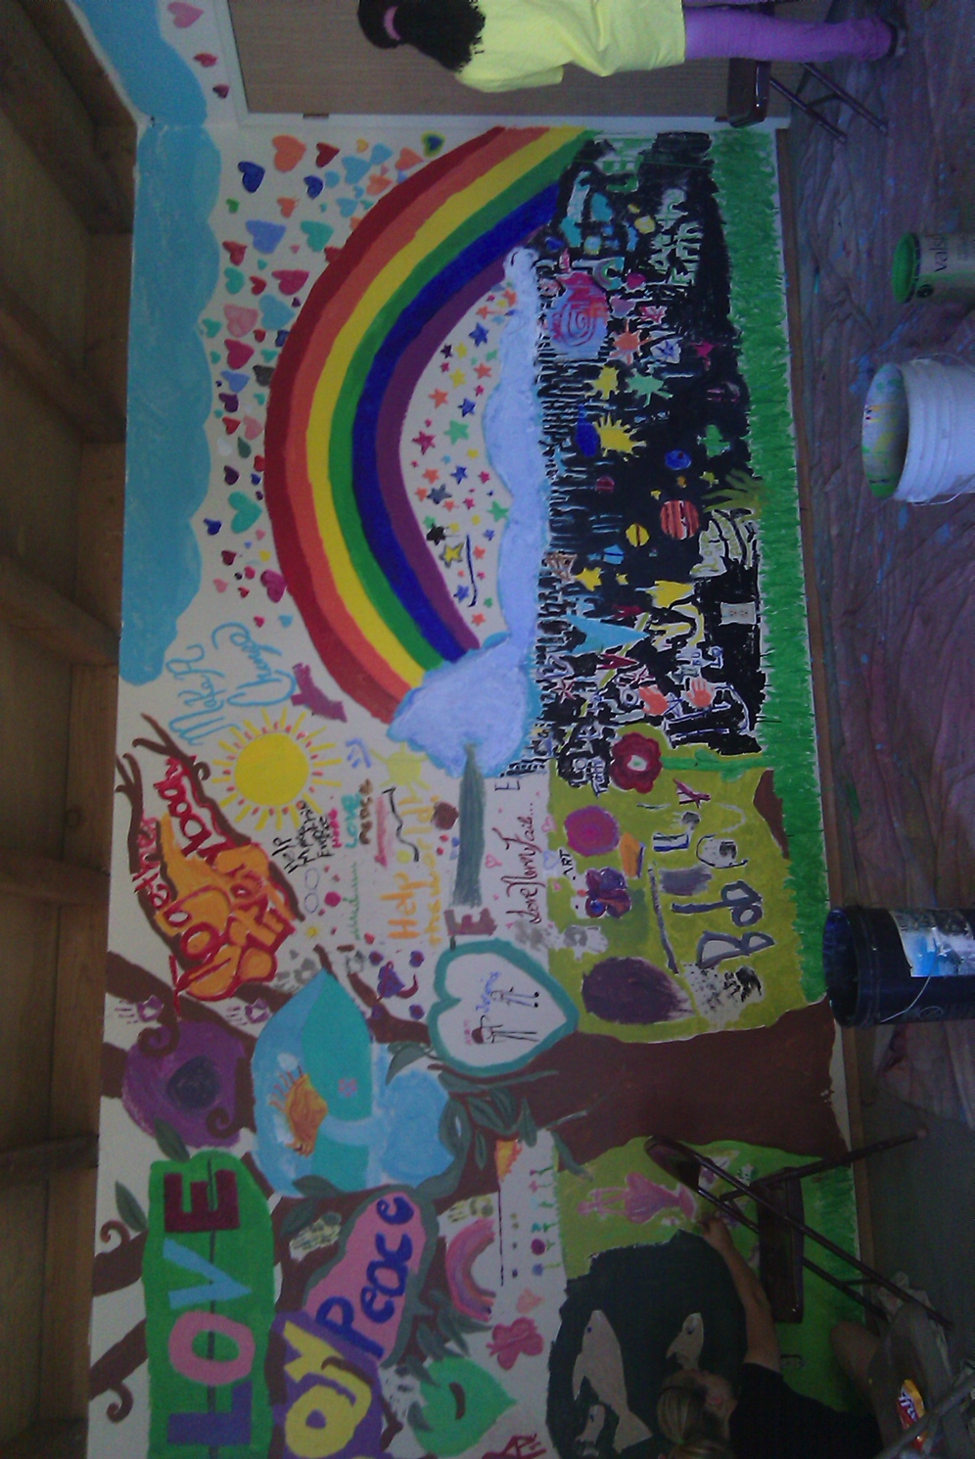
3rd year
Homework night (improved grades and better reading)
Sports activities
UC/College students engage with kids
Family members more active
Planning for garden, playground

Slide 13
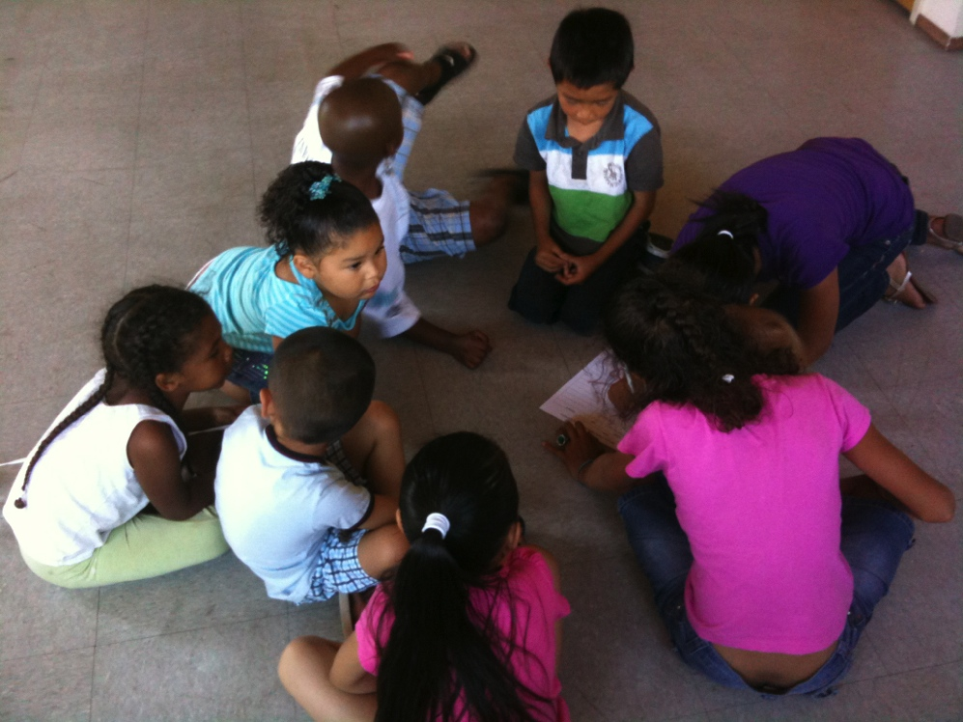
Possibilities are endless!
What will ONE life changed be worth?

Slide 14
Learn more!
MonikaGrasley@LifeLineCDC.org
www.LifeLineCDC.org
209.201.2905

